Slide 1
Using COMSOL On Kestrel, Part I: Introductory Tutorial
Xin He, Xin.He@NREL.gov
Complex Systems Simulation and Optimization Group
12.20, 2023
Notes:
Good morning, everyone. Welcome to this training. I am xin he from the complex systems simulation and optimization group. Today I am going to give a tutorial about using comsol on Kestrel.

Slide 2
Tutorial about COMSOL On Kestrel
I). Introductory tutorial
Introduction of COMSOL on Kestrel
Using COMSOL graphic user interface (GUI) on Kestrel
Running COMSOL in batch mode on Kestrel
Scaling performance
II). Advanced tutorial
Fuel cell model based
Parameter sweep
Batch sweep
Implement equations to COMSOL model
Notes:
This training for comsol on Kestrel is the first part of our planned training series which consists of an introductory tutorial and an advanced tutorial. In this introductory tutorial, we will talk about license of COMSOL on kestrel, using comsol graphic user interface and running comsol in batch mode on kestrel. For the advanced tutorial, we will cover parameter sweep, batch sweep, and the implementation of equations to comsol model based on a fuel cell model.
Scaling test, fixed model size, use different number of cores and observe the computing time. On kestrel, 104 cores per node. When study computing time using 104 cores, you need set –np*-nnhost=104, and try different combination of –np and –nnhost (keep –np*-nnhost=104) and get the case where the running time is minimum . If –np = 4, -nnhost = 26 yields the shortest time period, then use –np = 4 –nnhost=26 but change the number of nodes to repeat the simulation and plot curve for computing time versus number of nodes.
When the problem size is fixed, you can reach a point of negative returns when using additional processors As you compute with more and more processors, each processor has less and less amount of computation to perform The additional parallel overhead, compared to the amount of computation, causes the speedup curve to start turning downward as shown in the following figure.

Slide 3
About COMSOL
COMSOL Multiphysics® is a simulation platform that provides fully coupled multi-physics and single-physics modeling capabilities.
The real advantage of comsol is to enable multiphysic problem like fluid structure interactin to be carried out easily within it which is not the case for fluent requiring another structural solver (ansys..) to deal with.
https://www.comsol.com/comsol-multiphysics
Notes:
I think most of you has some experience in comsol. It is a simulation platform that provides fully coupled multi-physics and single-physics modeling capabilities. The real advantage of comsol compared to other commercial finite element software such as ansys and abaqus is to enable multiphysic problem like fluid structure interaction to be carried out easily within it which is not the case for fluent requiring another structural solver (in ansys..) to deal with. If you have a need of Multiphysics simulation, you should consider comsol.

Slide 4
Note
This tutorial is not about how to use COMSOL software, it focuses on enabling people to use COMSOL on Kestrel!
COMSOL documentation:
https://doc.comsol.com/6.1/docserver/#!/com.comsol.help.comsol/helpdesk/helpdesk.html
Modeling examples (1000+ models can be download):
https://www.comsol.com/models
Notes:
Unfortunately, this training series is not about how to use COMSOL software, while it focuses on enabling people to use COMSOL on Kestrel!
This introductory tutorial is specifically designed for people who has experience with using comsol on local workstation but has no experience or limited experience in running comsol on kestrel.
If you want to learn the software, you should refer to the documentation and the modeling examples through the links listed here.

Slide 5
Outline
1
COMSOL on Kestrel
- License
2
Running COMSOL Interactively with GUI
- DAV nodes
- FastX
3
Running COMSOL in Batch Mode
- File transfer
- Slurm/Sbatch Script
4
Demo
5
Scaling Performance
Notes:
Here is a more detailed outline of today’s tutorial. In the introduction section we will talk about comsol license on Kestrel. In second part we will cover how to run comsol GUI on DAV node on kestrel using fastX. Followed by the section about running comsol in batch mode in which file transfer and sbatch script will be talked in detail. At the end, we will do a demo which covers the most stuff in the first three sections using a simple cantilever beam model. My Hope on this tutorial is that it will serve as a quick start manual and enable people to use comsol on kestrel easily.

Slide 6
COMSOL on Kestrel
Version: COMSOL 6.1
License: 3 COMSOL (GUI) licenses
Available Modules:
Battery Design, 1
Fuel Cell and Electrolyzer: 1
CFD: 1
Heat Transfer: 1
Structural Mechanics: 1
Chemical Reaction : 1
Particle Tracing: 1
Radio frequency: 2
Semiconductor: 1
LLMATLAB: 1
CAD Import: 1
CAD Reader: 1
LLExcel: 1
Notes:
All right. Let’s get started. The version of COMSOL installed on Kestrel is COMSOL 6.1. we have 3 comsol licenses in total. The available modules are list here. Including battery design, fuel cell and electrolyzer, CFD, heat transfer, structure mechanics, chemical reaction, particle tracing, RF for electromagnetic wave, semiconductor, and interface with matlab, excel and CAD.
Github markdown page part of repo, point people to there. So can refer this training later.

Slide 7
COMSOL License On Kestrel VS from ITS
From ITS: shared license and can be requested to be installed on local workstation.
On Kestrel: floating network license which enable running COMSOL in parallel. Anyone who has HPC account can use it.
Notes:
All right. Let’s get started. The version of COMSOL installed on Kestrel is COMSOL 6.1. we have 3 comsol licenses in total. The available modules are list here. Including battery design, fuel cell and electrolyzer, CFD, heat transfer, structure mechanics, chemical reaction, particle tracing, RF for electromagnetic wave, semiconductor, and interface with matlab, excel and CAD.

Slide 8
COMSOL on Kestrel
Check Status of License
lmstat.comsol command has not been ported to Kestrel, you need create your own lmstat.comsol script to check the license status as follows:
cd ~ # change directory to your home directory
mkdir check_license_status_comsol # create a folder to save the command file
cd check_license_status_comsol # change directory to the created folder
touch lmstat.comsol # create an empty file
Copy the following commands to lmstat.comsol and save it
#!/bin/bash
BASEDIR=/nopt/nrel/apps/software/comsol/6.1/comsol61/multiphysics/license/
$BASEDIR/glnxa64/lmstat -c $BASEDIR/license.dat -a
Add executable permission:
chmod +x ~/check_license_comso/lmstat.comsol
Run lmstat.comsol:
~/check_license_comsol/lmstat.comsol
Notes:
First of first, Before running comsol, I recommend to check the status of license.
On eagle, it is easy to check the license status by running lmstat.comsol command, however, this command has not been ported to kestrel which means you need create you own lmstat.comsol command. The steps to do this is shown here. Firstly, you need create an empty file named with lmstat.comsol and copy the script to this file and save it. Then add executable permission to this file. After that, you should be able to run lmstat.comsol command.

Slide 9
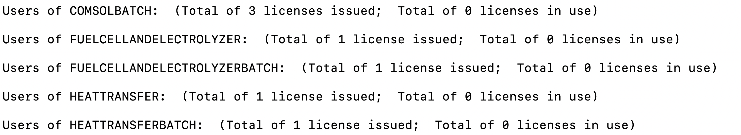
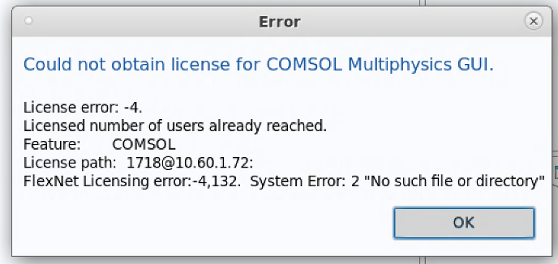
COMSOL on Kestrel
Check Status of License
Notes:
The running of lmstat.comsol command will list the number of total and available license for each module like this. If all license are checked out, you are not able to open the gui interface or run any comsol jobs. It will give error information like this. So I highly recommend you to check the license status before running comsol.

Slide 10
COMSOL on Kestrel
Ways to use COMSOL on Kestrel
Build model and run it through GUI on Kestrel
Build model in GUI on Kestrel and run it in batch mode on Kestrel
Build model in GUI on local workstation and run it in batch mode on Kestrel
Notes:
In this introductory tutorial, we will introduce tthree ways to run comsol model. The first way is creating and calculating the model in the graphic interface completely on kestrel while the second way is to build the model in GUI on Kestresl and calculate it in batch mode. The third way is to build the model in GUI on your local workstation and run it in batch mode on Kestresl. The third one requires files transferred between the local workstation and kestrel.

Slide 11
Running COMSOL Interactively with GUI
DAV Nodes and FastX
In addition to standard ssh-only login nodes, Kestrel is also equipped with specialized Data Analysis and Visualization (DAV) login nodes, intended for HPC applications that require a graphical user interface (GUI).
Kestrel: 7 DAV nodes (kd1, kd2, kd3, kd4, kd5, kd6, kd7)
ssh user@kestrel-dav.hpc.nrel.gov or
ssh user@kd1.hpc.nrel.gov
FastX
FastX provides a means to use a graphical desktop remotely. By connecting to a FastX session on a DAV node, users can run graphical applications with a similar experience to running on their laptop.
Notes:
Let’s go through the steps for using comsol GUI first. A little bit of difference from Eagle. You can only run comsol gui on a data analysis and visulization node. Which is intended for HPC applications that require a graphical user interface (GUI). There are 7 dav nodes on kestrel. Ssh kestrel-dav will log you into one of the 7 dav node randomly. Of course, you can log into a specific dav node by specifying the name of dav node you want to login.
In order to run comsol gui, a x-window application is required. Here I am using fastx. FastX provides a means to use a graphical desktop remotely. By connecting to a FastX session on a DAV node, users can run graphical applications with a similar experience to running on their laptop. There are two ways to use fastX, including browser client and desktop client.

Slide 12
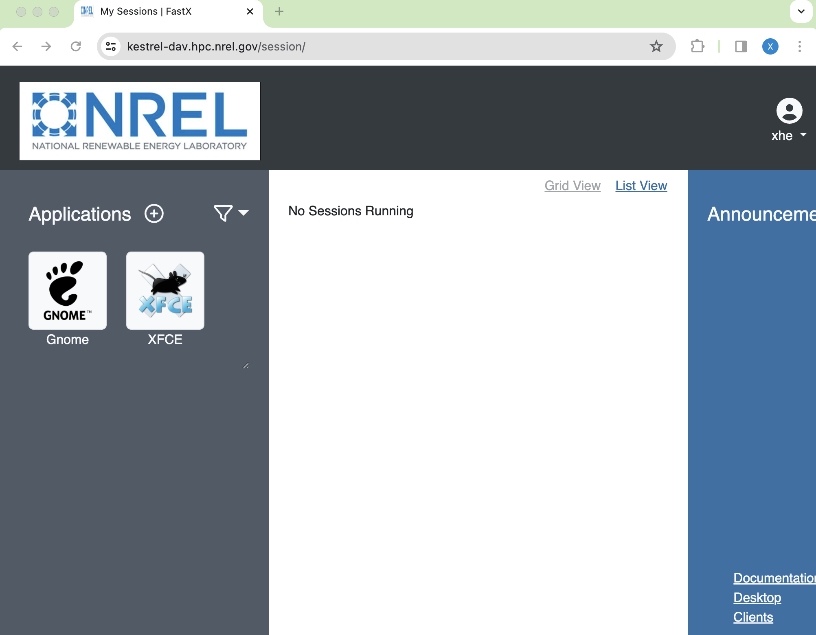

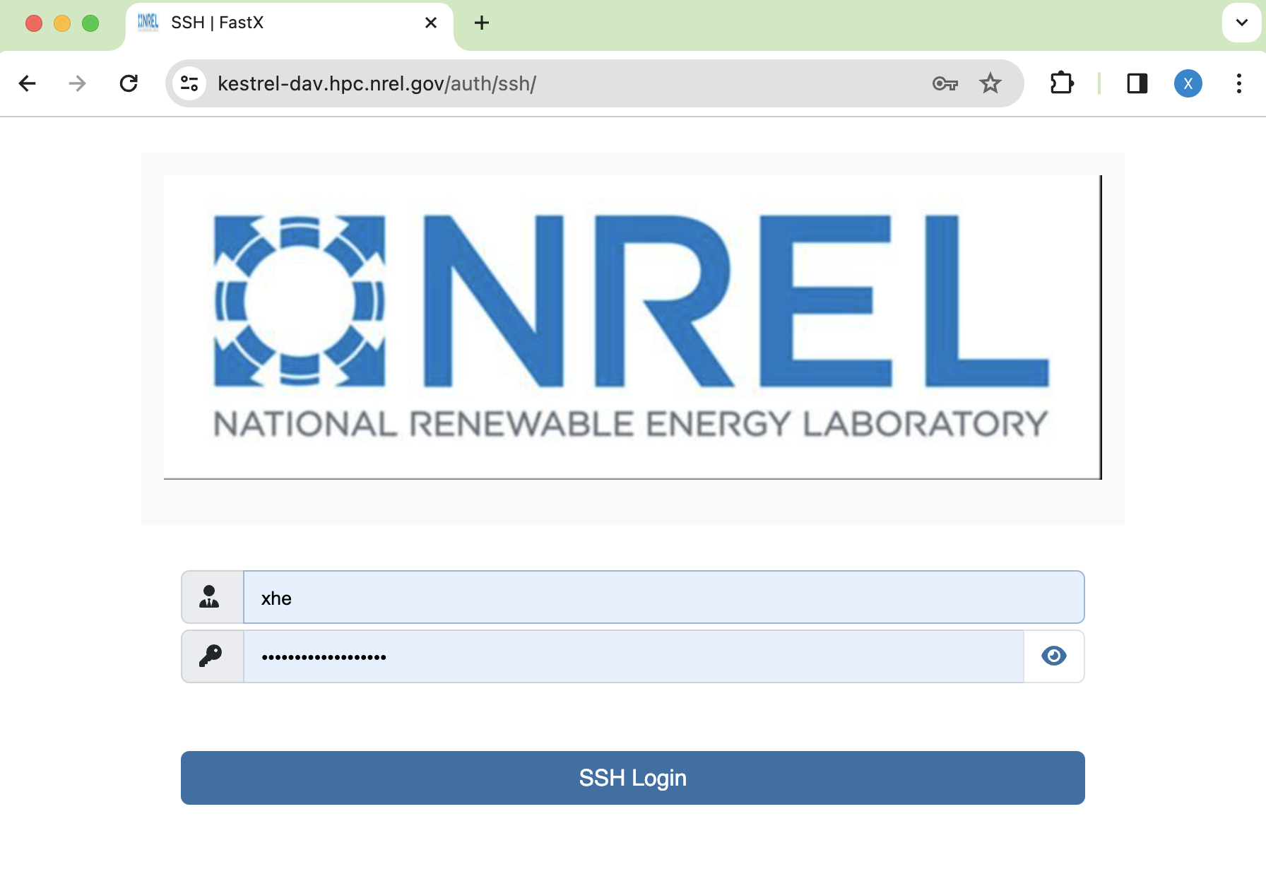

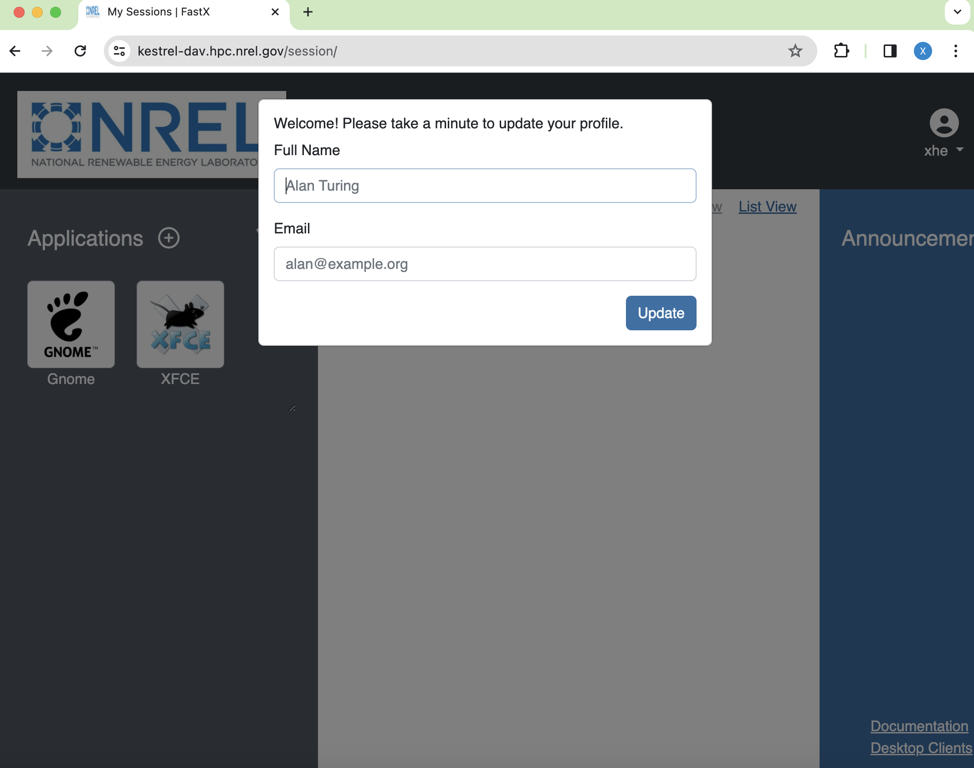
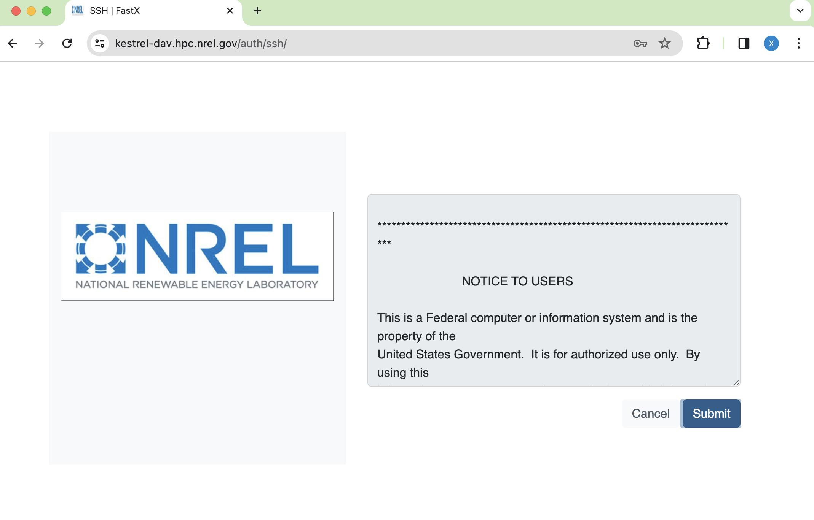
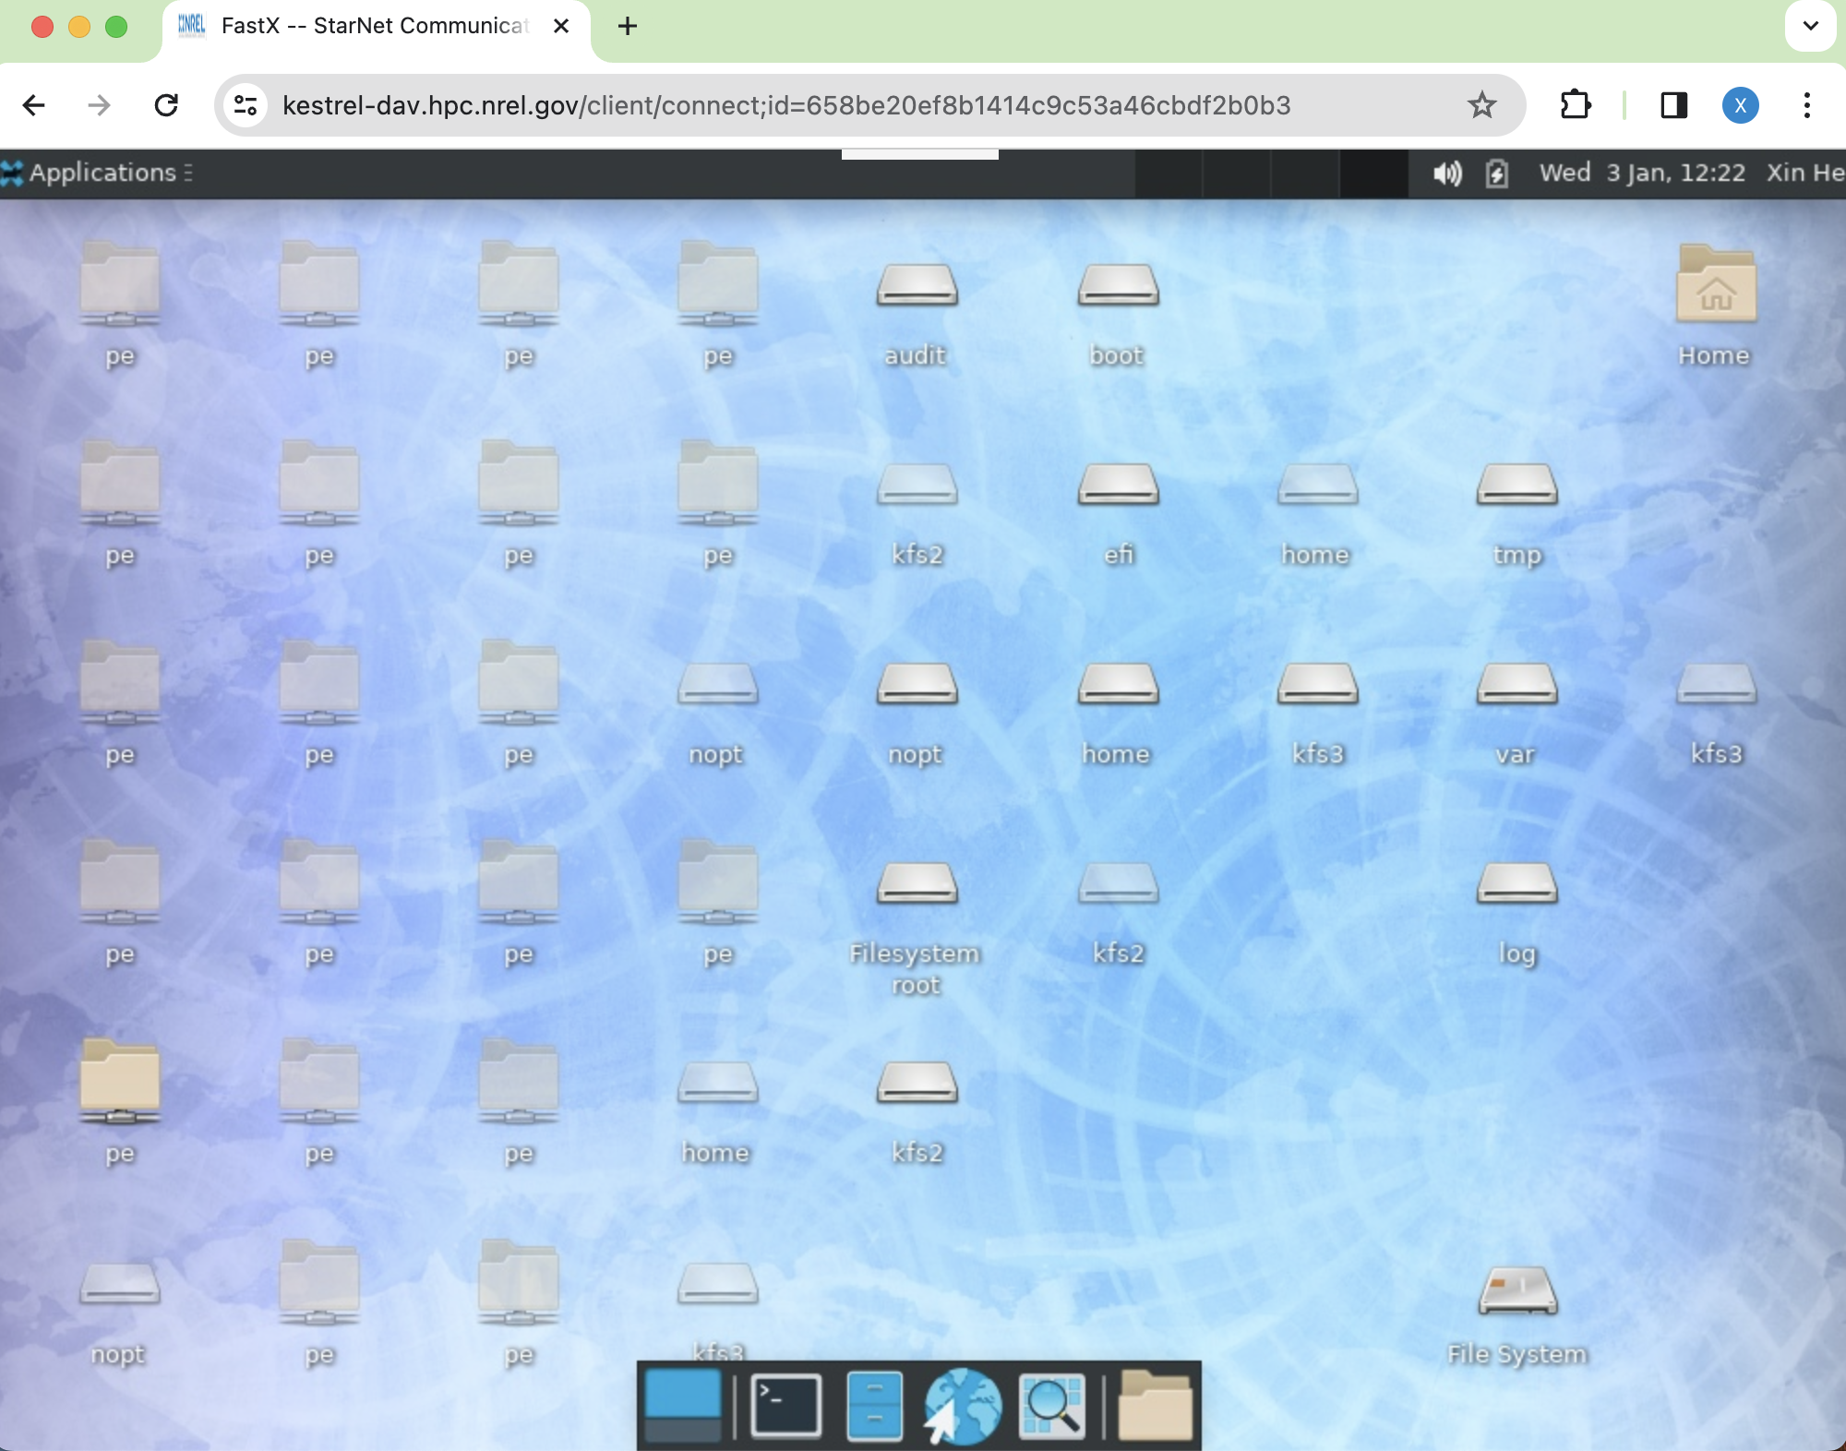
Running COMSOL Interactively with GUI
FastX (browser client)
Type the name of the server into the URL box of your browser:
kestrel-dav.hpc.nrel.gov
or
kd1.hpc.nrel.gov (specify which dav node)
3. Click the submit button
6. Click XFCE tag to create a connection
4. Click the proceed button
2. Type your username and password
of your HPC account
7. Select Browser Client
5. Type your full name and email address, then click Update
Notes:
Let’s start with the browser way as it is simple, and you don’t need to install the application. Fastx browser client support most browser such as Chrome, Firefox, Safari, Edge. The first step is to tyoe the name of the server into the URL box of your browser. For kestrel it is kestrel-dav.hpc.nrel.gov or you can specify which DAV node to login using kd number of the specific dav node.hpc.nrel.gov. it will bring you to this page, in which you need type your username and password of your HPC account and click ssh login button. Then this page will appear, click submit it will goes to the notice to user page, click proceed. The xwindow will pump up. You can just click the update button to get rid of this pumped window.click xfce tag to open a connection and it will let you choose either browser client or desktop client, here we are using browser client. Once you click crowser client tag, the desktop of kestrel will show up.

Slide 13
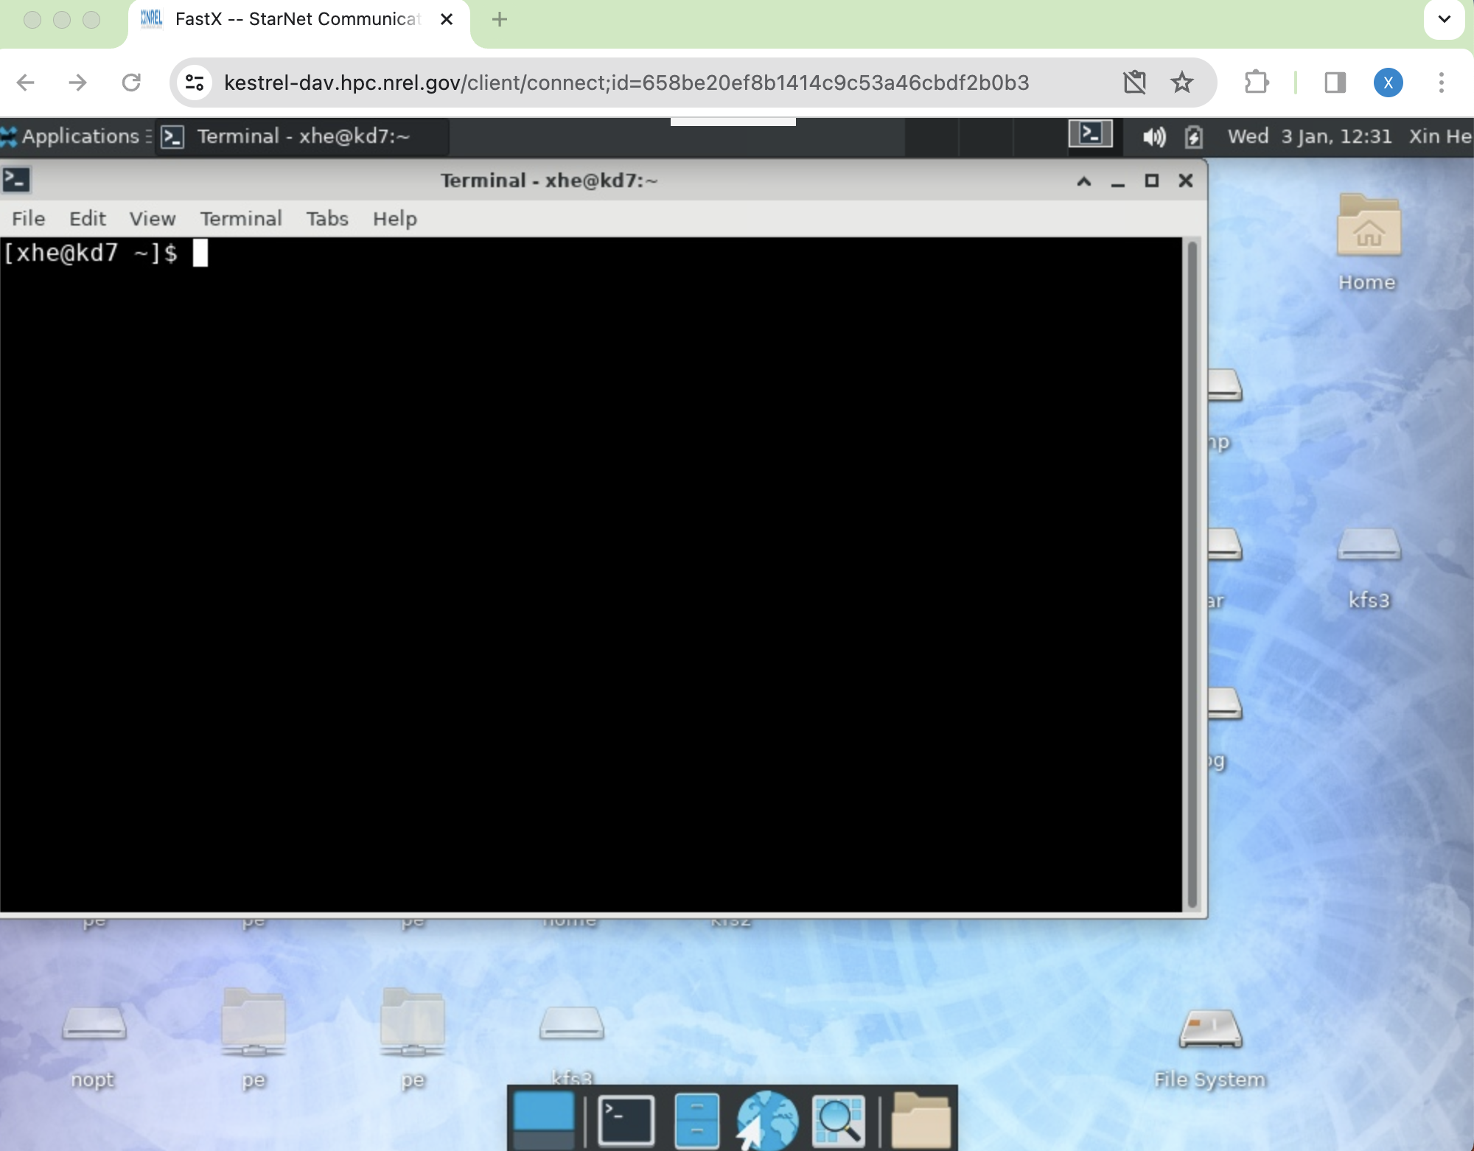
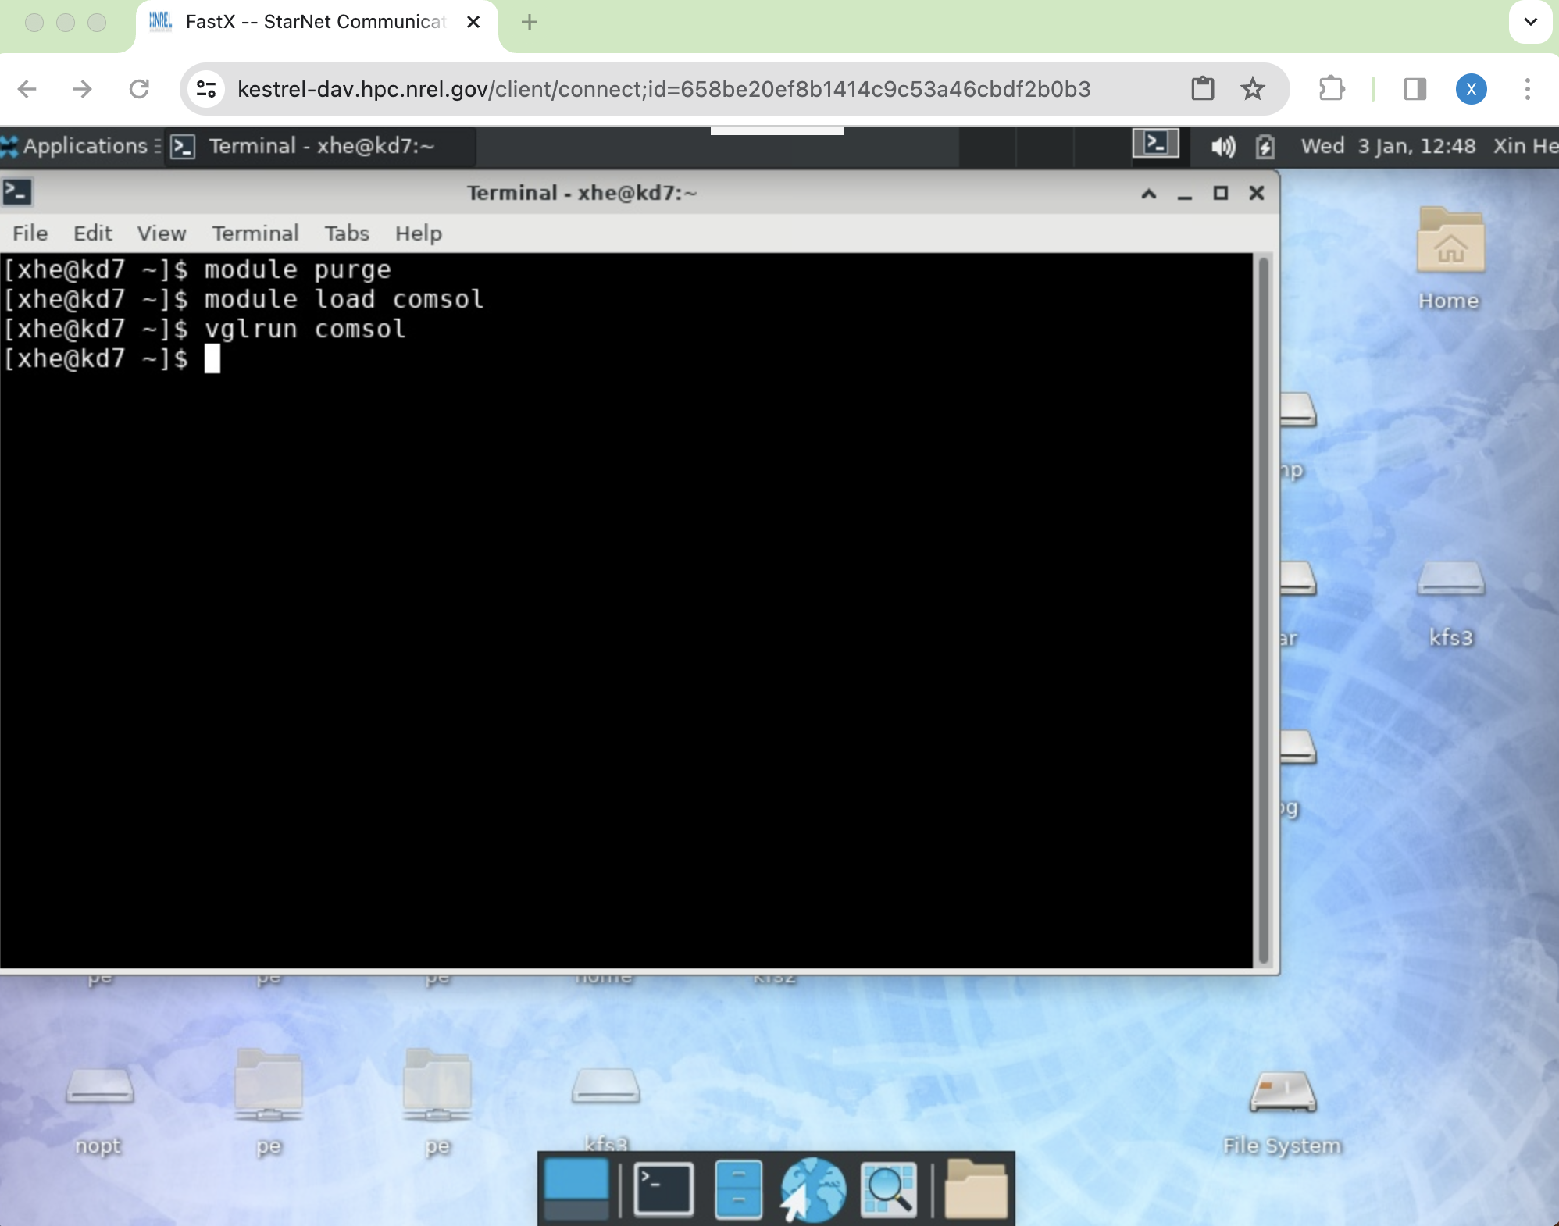
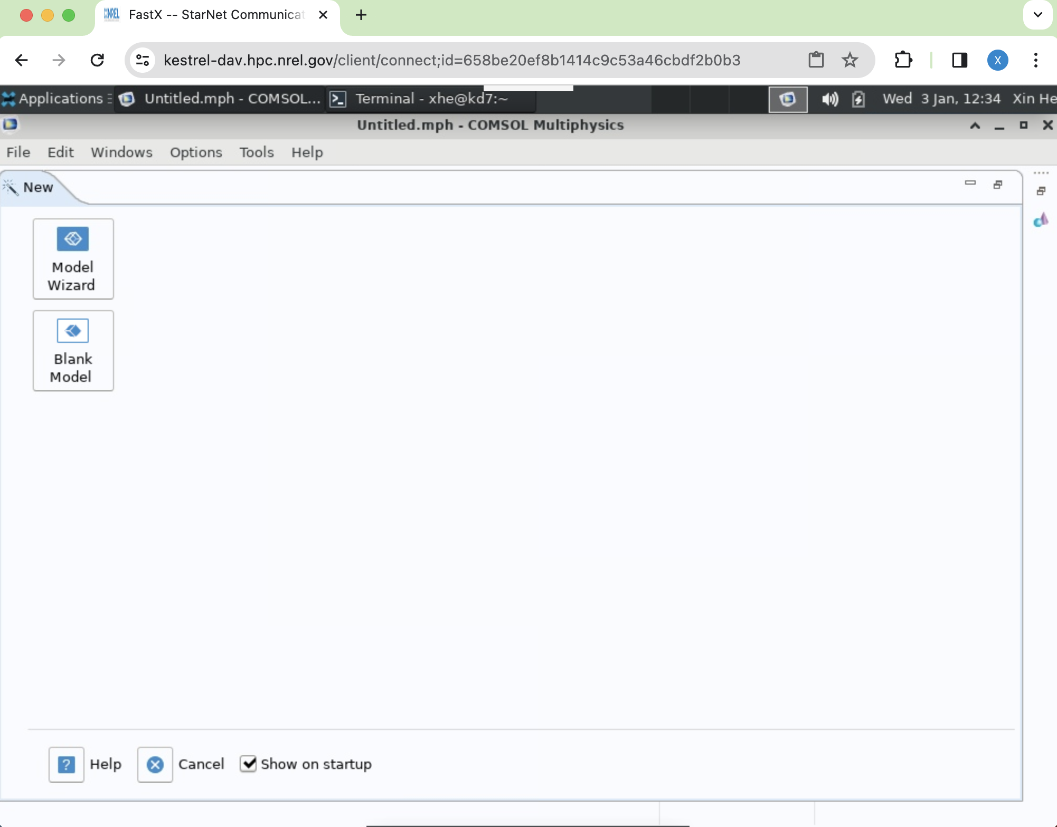
Running COMSOL Interactively with GUI
FastX (browser client)
9. Type following code in the terminal:
module purge
Module load comsol
Vglrun comsol
8. Open a terminal
10. COMSOL GUI is opened
Notes:
In order to open comsol gui, we need open a terminal by clicking the terminal icon as highlighted here. In the opened terminal type module purge, hit enter
Then module load comsol, hit enter, then vglrun comsol hit enter. The comsol gui will show up.
The first command release all loaded modules, and the second command load comsol module while the third command pump up the comsol gui.
This is how to use fastx browser client to open comsol gui. Next let’s see how to use the fastx desktop client.

Slide 14
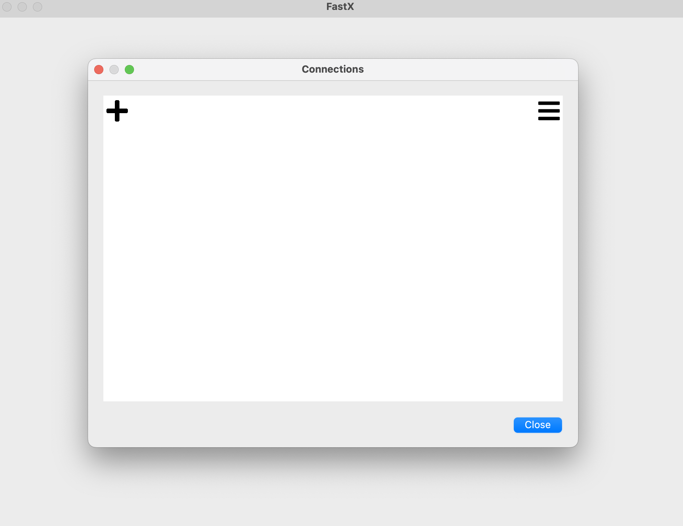
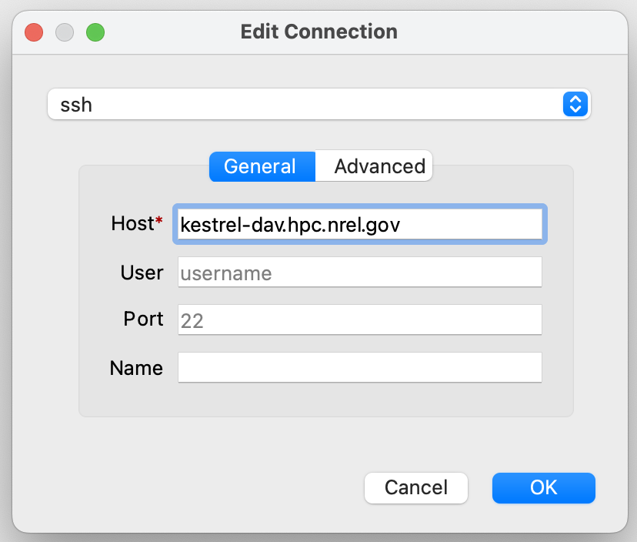
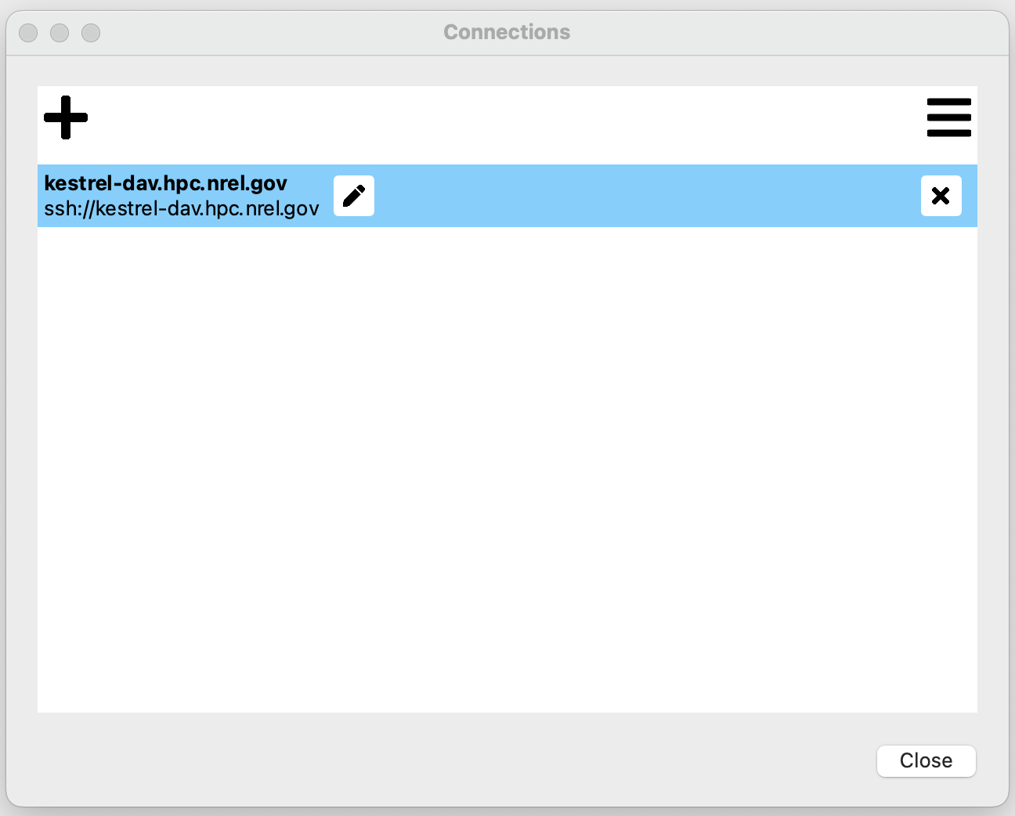
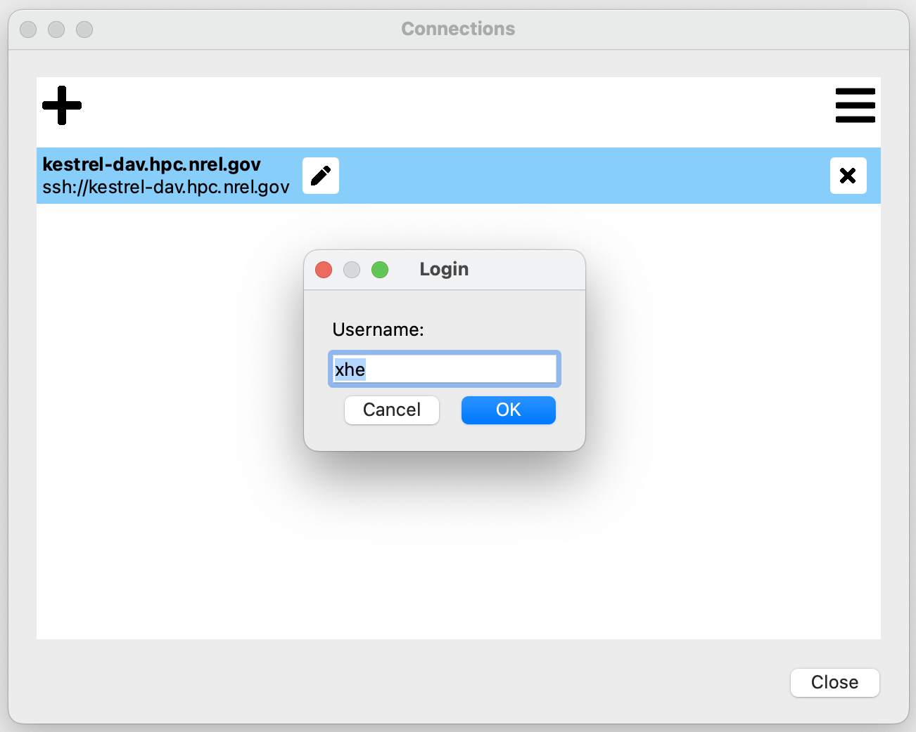
Running COMSOL Interactively with GUI
FastX (desktop client)
Download FastX:
https://www.starnet.com/download/fastx-client
Connect to DAV node:
1. Open FastX application
2. Add a connection by
clicking ‘+’ symbol, input
the host name and username
3. Double click the highlighted connection
4. Input your HPC account username
Notes:
To use the fastx desktop client, you need install the fastx application on your local workstation.
You can download fastx through this link. After install fastx and open it, we can connect to a DAV node on kestrel by specifying the host name and inputing your username and password of your hpc account. The following steps are the same as that for browser client. Once you are logged into a DAV node, then you can add a xfCE window and the desktop of Kestrel will show up.

Slide 15
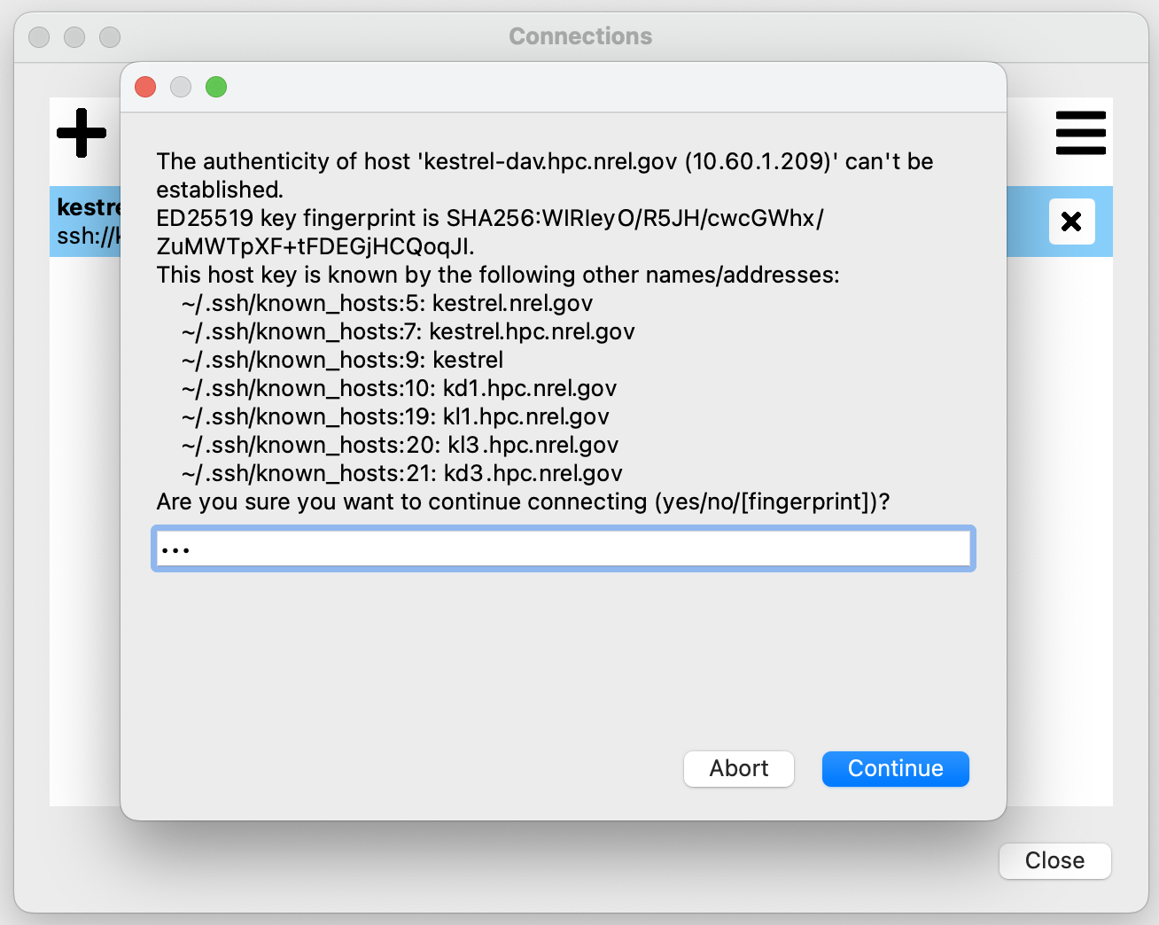
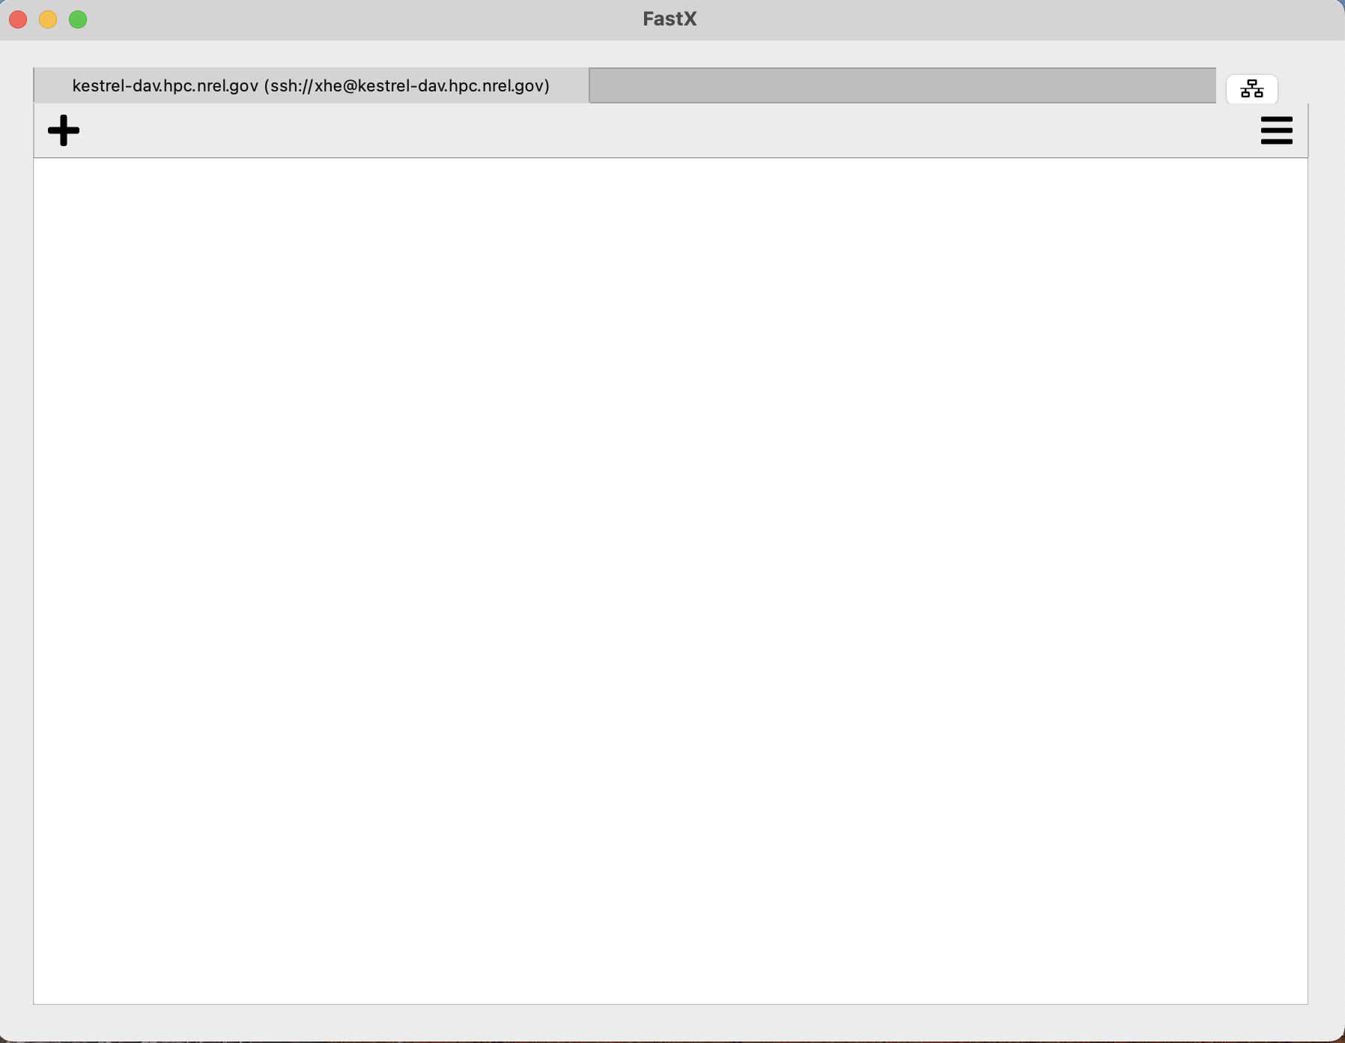
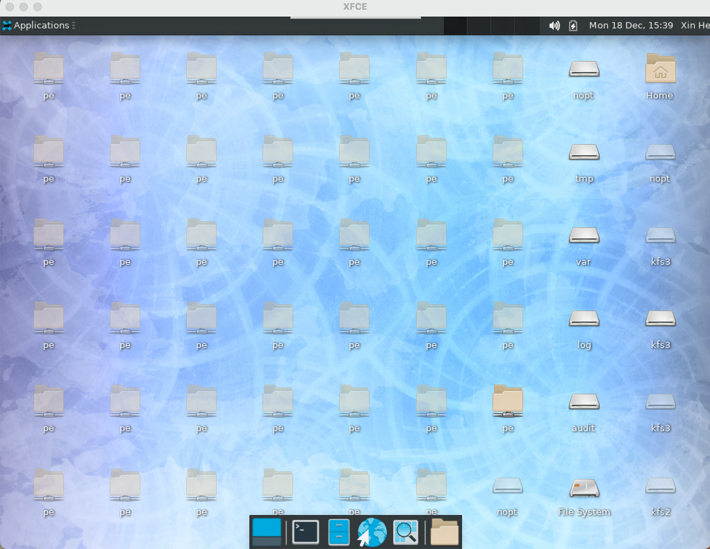

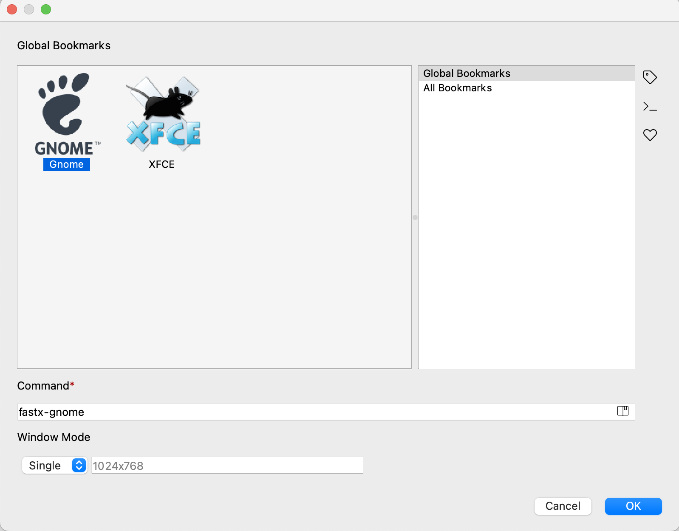
Running COMSOL Interactively with GUI
FastX (desktop client)
5. Type ‘yes’
7. Click ‘+’ to add Xwindow
9. Kestrel desktop is opened
6. Input your password of your hpc account
8. Select XFCE
Notes:
To use the fastx desktop client, you need install the fastx application on your local workstation.
You can download fastx through this link. After install fastx and open it, we can connect to a DAV node on kestrel by specifying the host name and inputing your username and password of your hpc account. The following steps are the same as that for browser client. Once you are logged into a DAV node, then you can add a xfCE window and the desktop of Kestrel will show up.

Slide 16
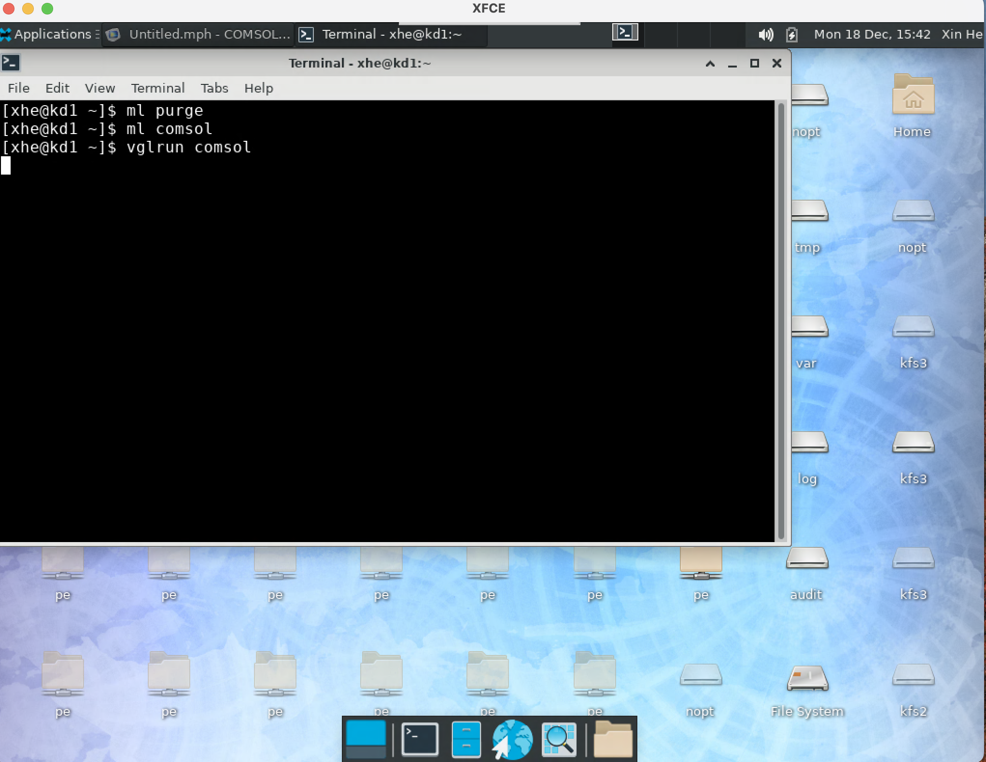
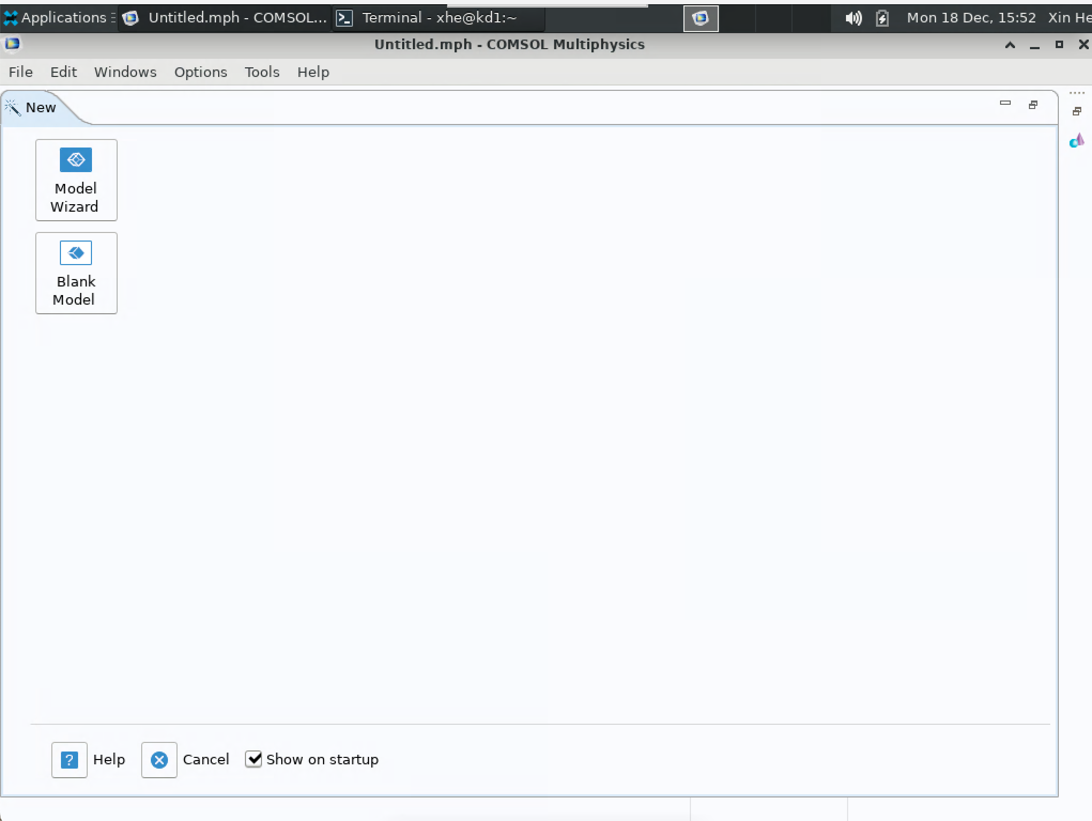
Running COMSOL Interactively with GUI
FastX (desktop client)
10. Open a terminal and input the script:
ml purge
ml comsol
vglrun comsol
Notes:
start a terminal window and run these commands. Comsol gui will start.

Slide 17
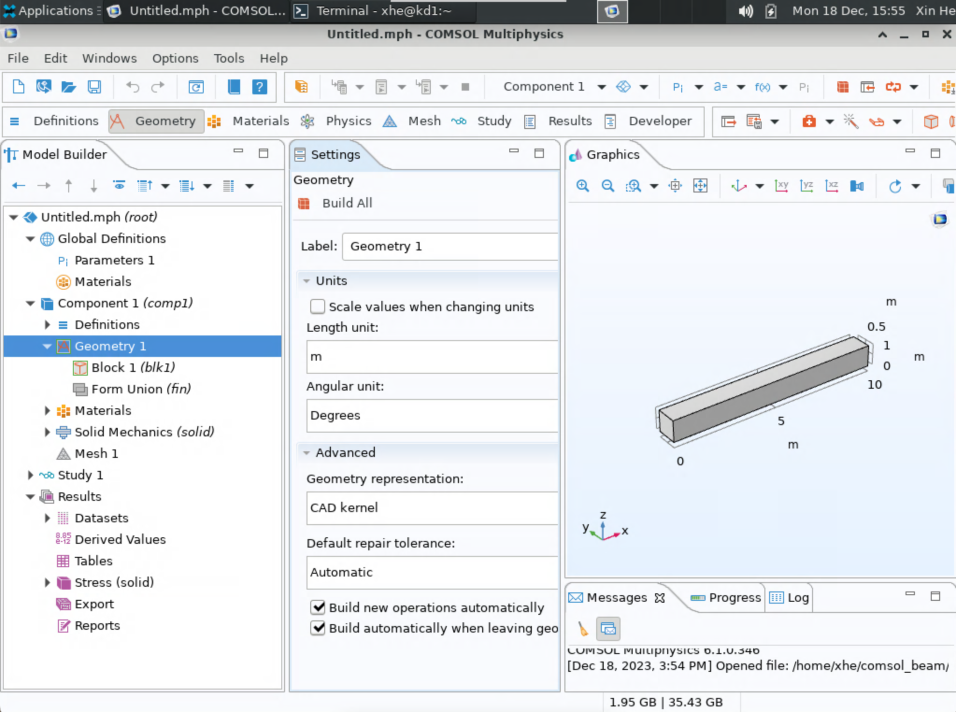
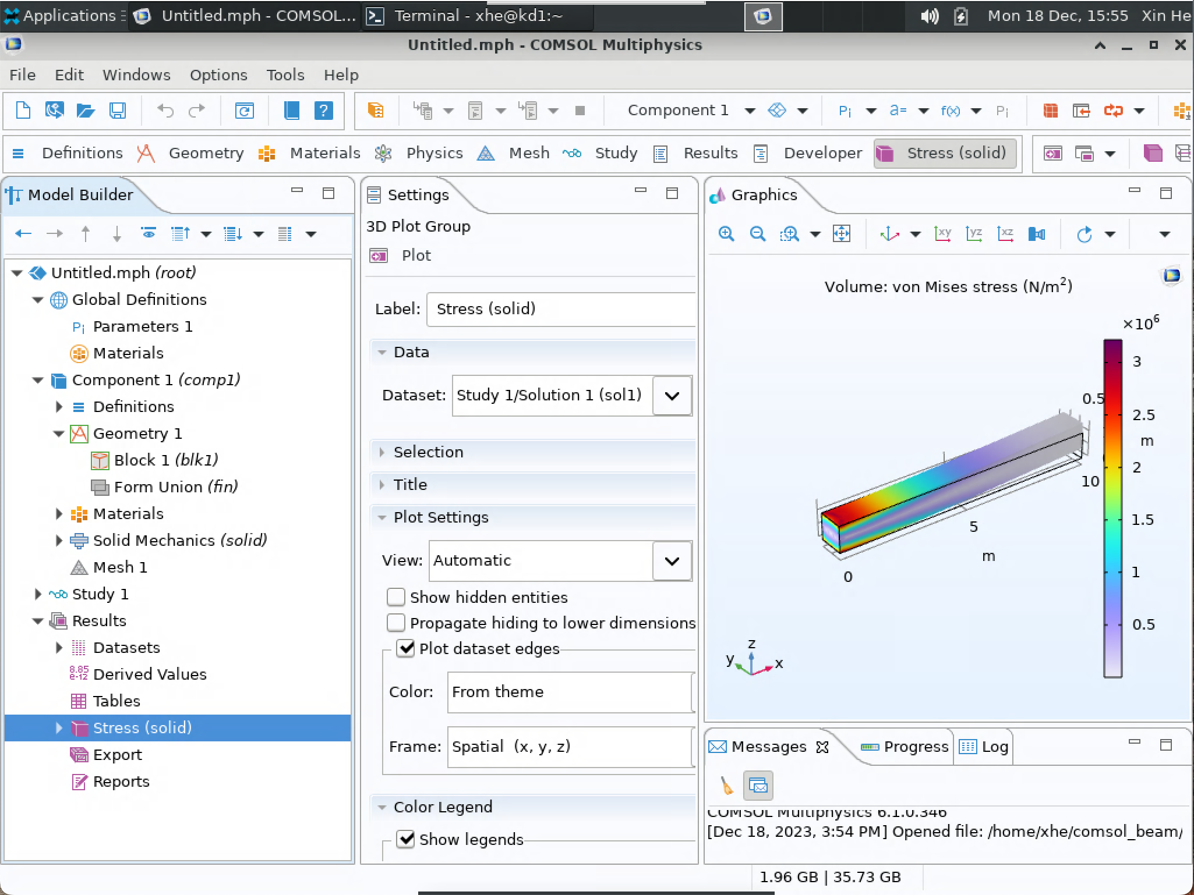
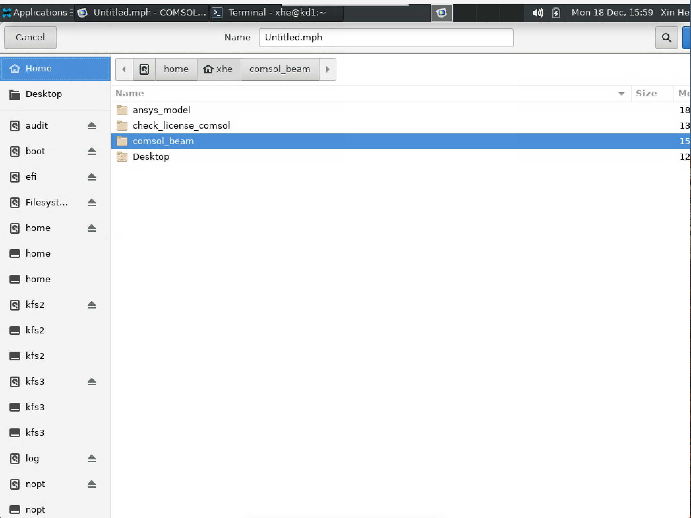
Running COMSOL Interactively with GUI
Build and compute the model as same as that on your laptop
Save the model
- Save the model to your project directory, the
space of your home directory is limited.
- It is computed on DAV node.
- By default, COMSOL use all cores of the
DAV node (2 sockets and 104 nodes for
each DAV node).
Notes:
In the gui, you can build and compute the model as same as that on your local laptop. Once you finish you can save the model on Kestrel to your home directory.
In this way, the model is calculated on DAV node, by default, comsol use all cores of the DAV node.

Slide 18
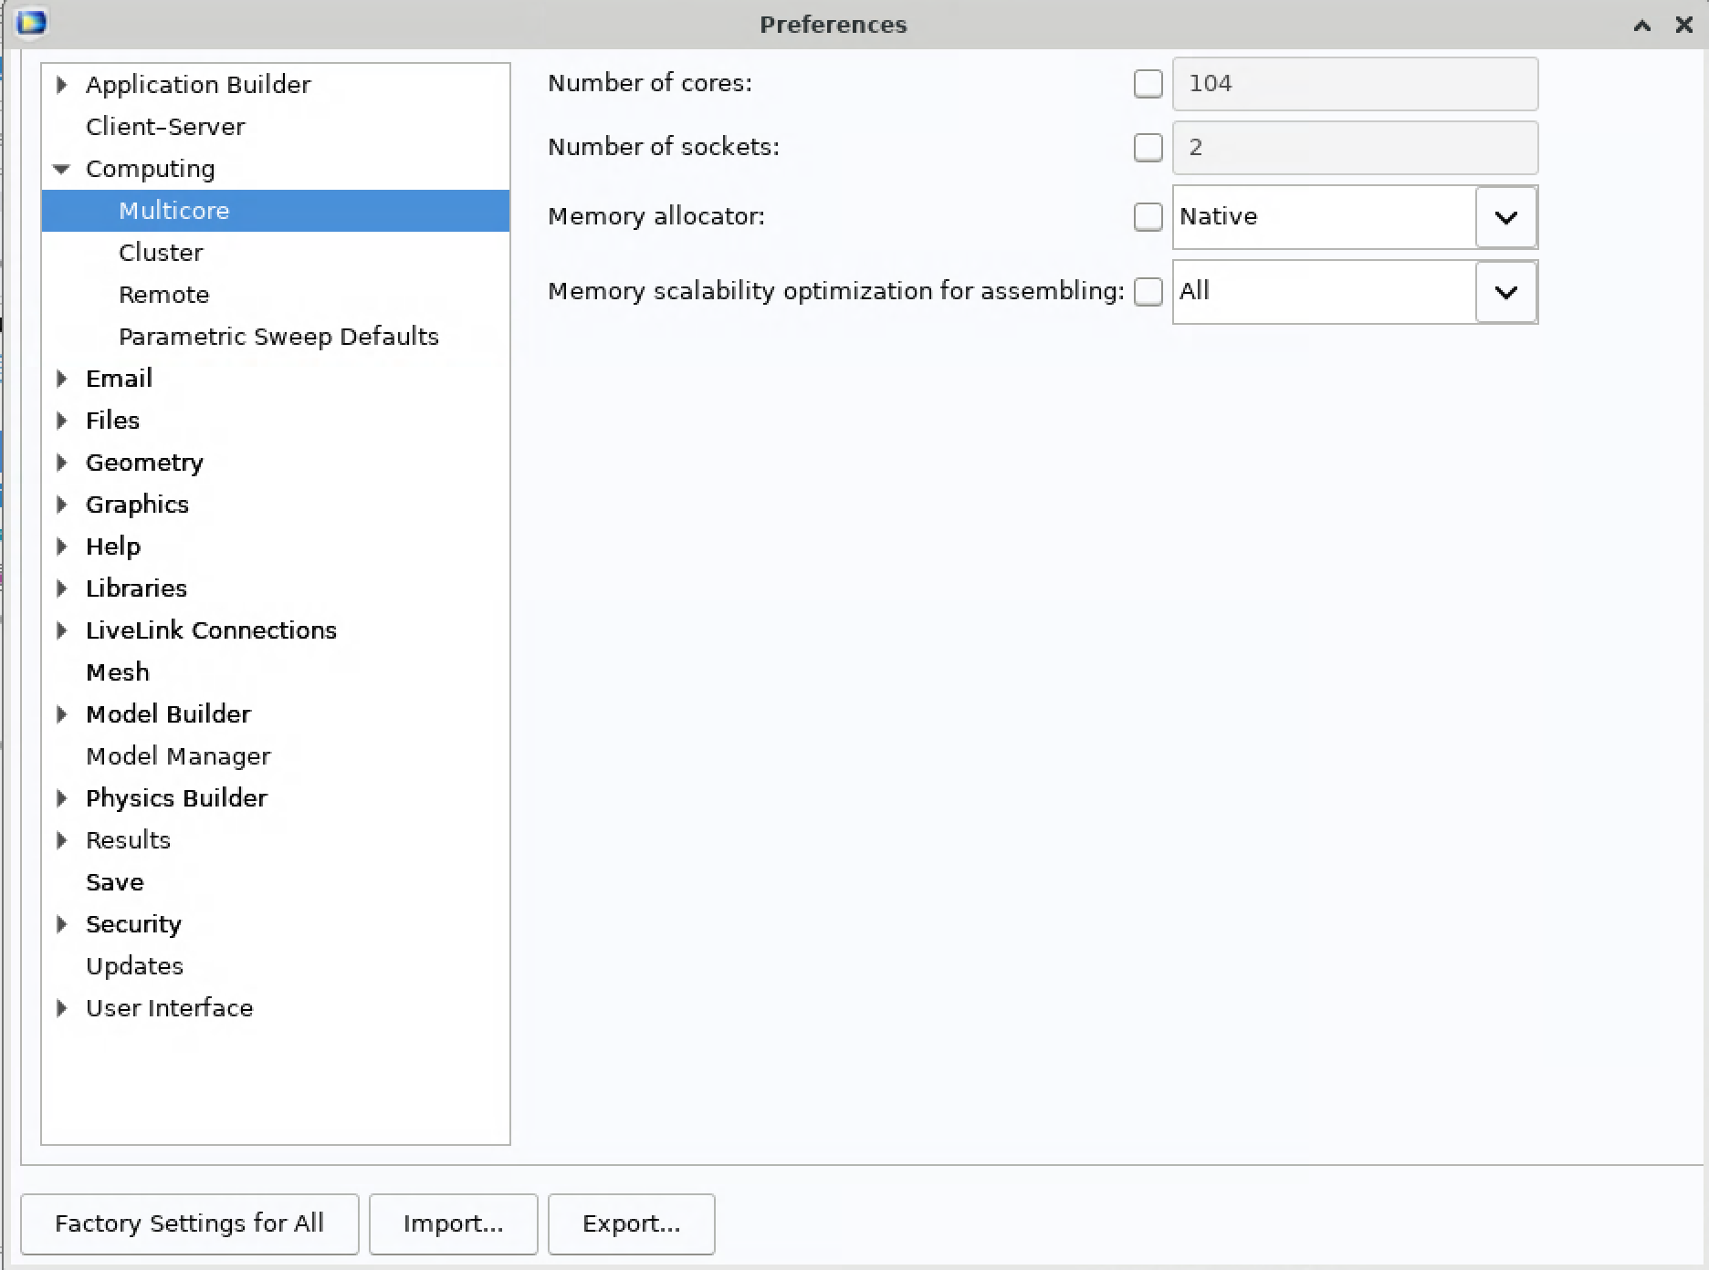
Running COMSOL Interactively with GUI
Change number of cores:
- Options > Computing > multicore
- Not straight forward to run on multiple nodes through GUI
- Running on DAV nodes is not recommended, you are sharing the cores with other users, the computational speed may be slow on DAV node
Notes:
If you want to change the number of cores and socket that comsol will utilize, you can go to options-computing,-multicore tap to modify. However, running comsol model in multiple nodes through GUI is not straight forward. I recommend to run it in batch mode if you need multiple nodes for model with lot of DOFs.

Slide 19
Running COMSOL In Batch Mode
1. Once the model is built in GUI on either Kestrel or local workstation, copy and save the .mph to your home directory or project directory.
2. Write a sbatch script used to submit the model to be analyzed.
3. Calculate the COMSOL model on a compute node by submitting the sbatch file from the directory where it is saved.
Notes:
Next, let’s move forward to next topic about running comsol in batch mode. Once the model is built in GUI on either Kestrel or local workstation, copy and save the .mph to your home directory or project directory on kestrel. Then you need to write a sbatch script, by submitting the sbatch file from the directory where it is saved the comsol model will be calculated on a compute node.

Slide 20
Running COMSOL In Batch Mode
File transfer
Model created in COMSOL GUI on local machine
Local Workstation
Kestrel
Computed COMSOL model on Kestrel
Cyberduck can be used to securely transfer files between your local computer running Windows, Linux or MacOS to a remote computer running Linux.
Cyberduck: https://cyberduck.io/
Notes:
Next, let’s move forward to next topic about running comsol in batch mode. Once the model is built in GUI on either Kestrel or local workstation, copy and save the .mph to your home directory or project directory on kestrel. Then you need to write a sbatch script, by submitting the sbatch file from the directory where it is saved the comsol model will be calculated on a compute node.

Slide 21
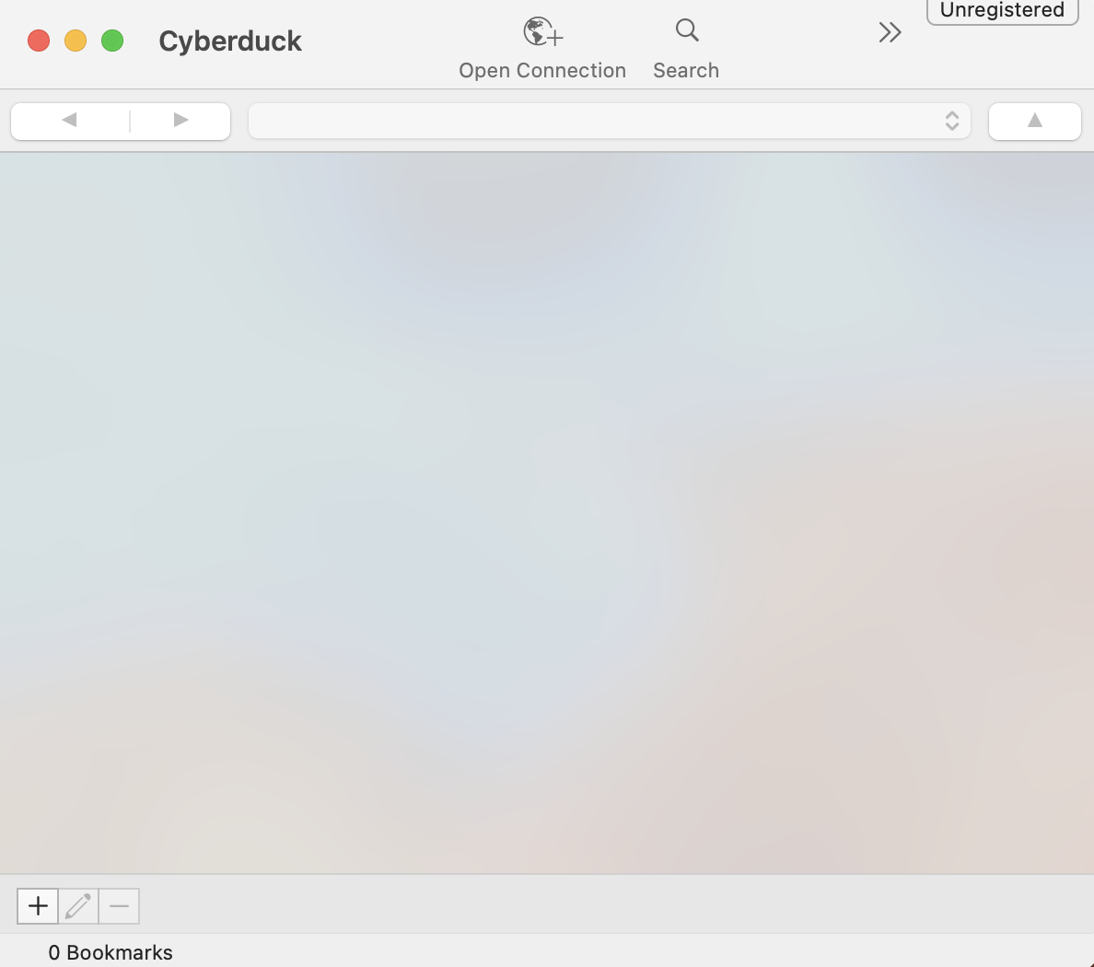
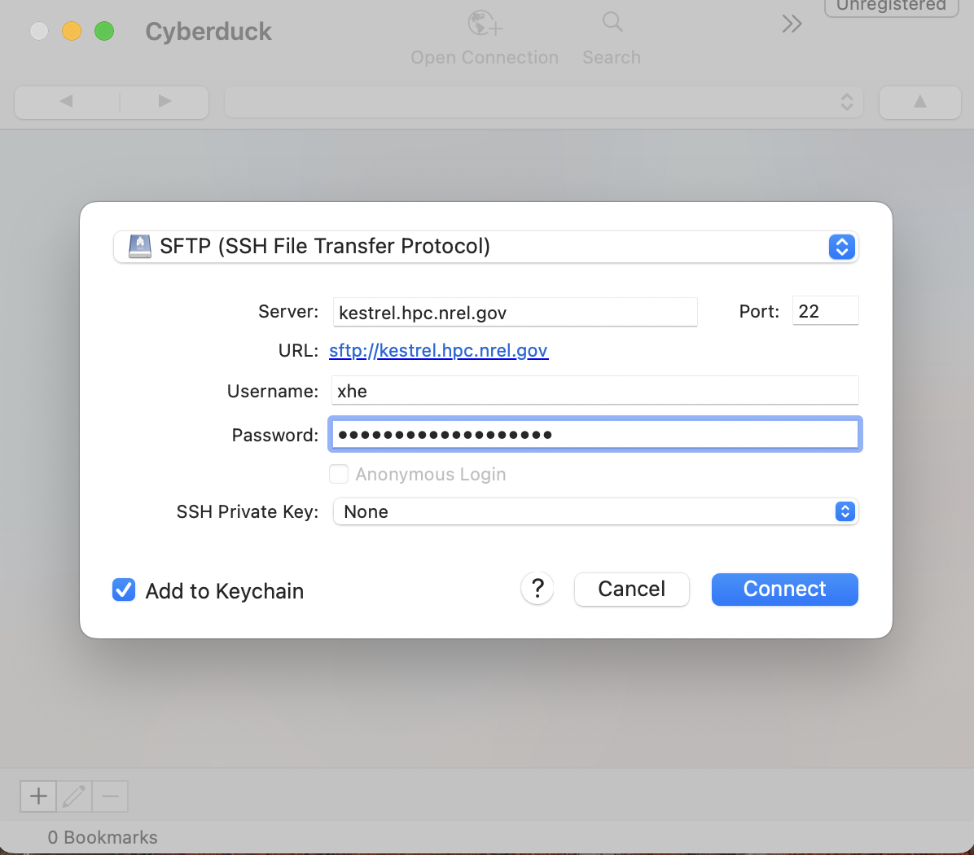
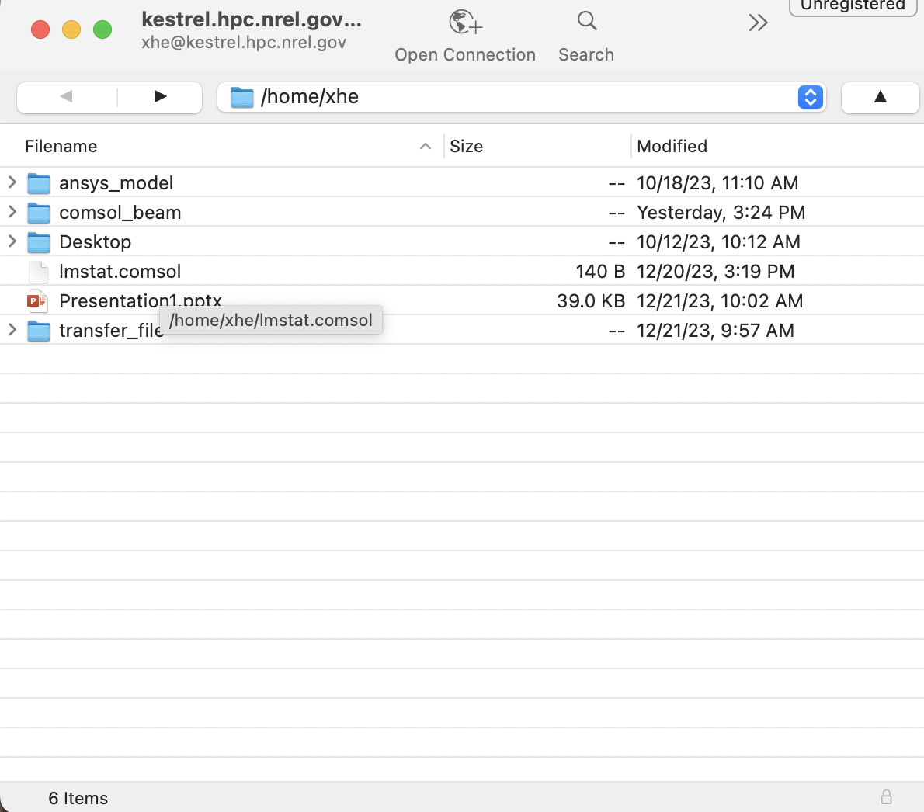
Running COMSOL In Batch Mode
File transfer: setup cyberduck
2. Open connection
- SFTP(SSH File Transfer Protocol)
- Server: kestrel.hpc.nrel.gov
- port: 22
- Username
- Password
1. Open Cyberduck application
3. Shows home directory on Kestrel
Notes:
Next, let’s move forward to next topic about running comsol in batch mode. Once the model is built in GUI on either Kestrel or local workstation, copy and save the .mph to your home directory or project directory on kestrel. Then you need to write a sbatch script, by submitting the sbatch file from the directory where it is saved the comsol model will be calculated on a compute node.

Slide 22
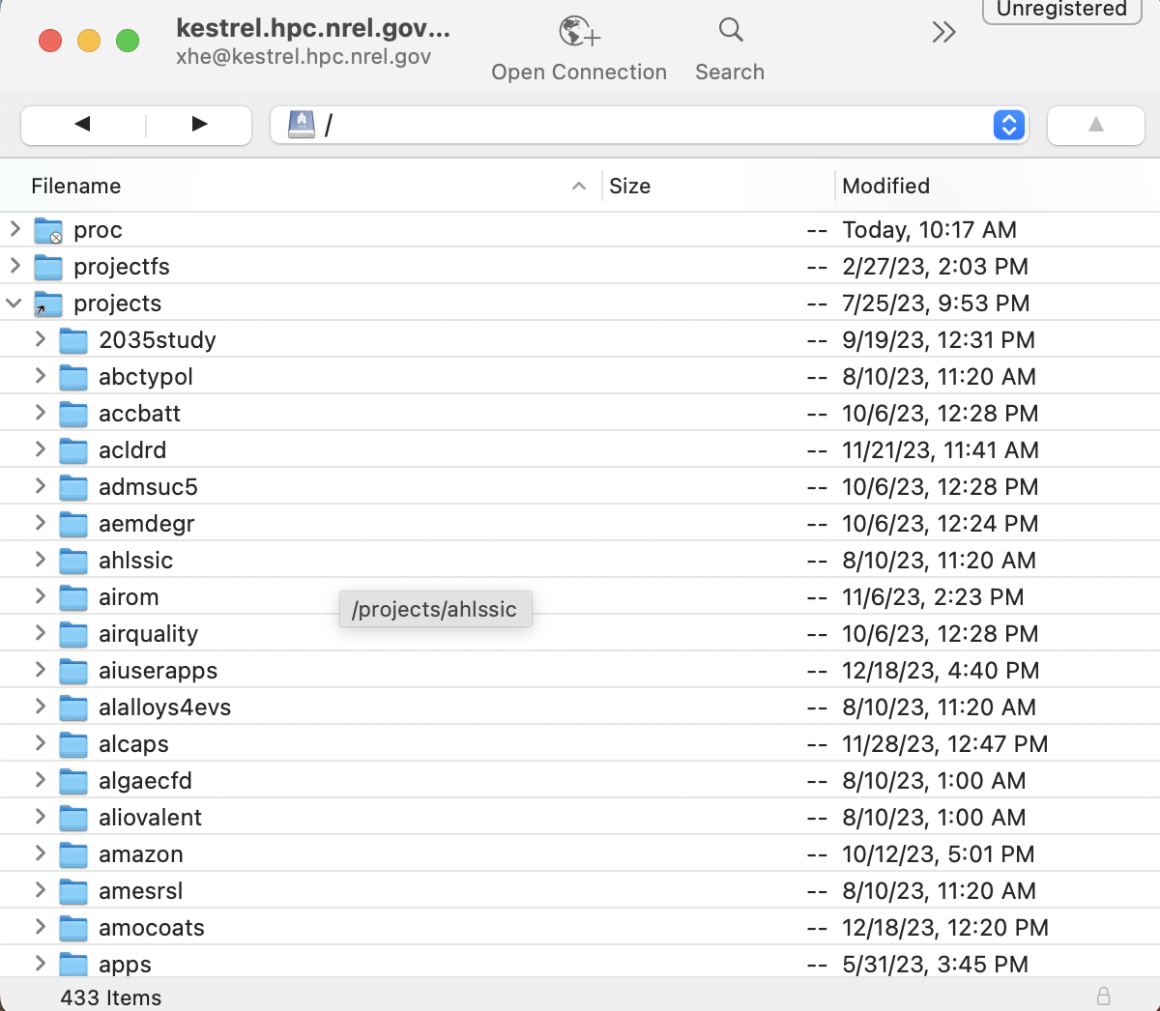
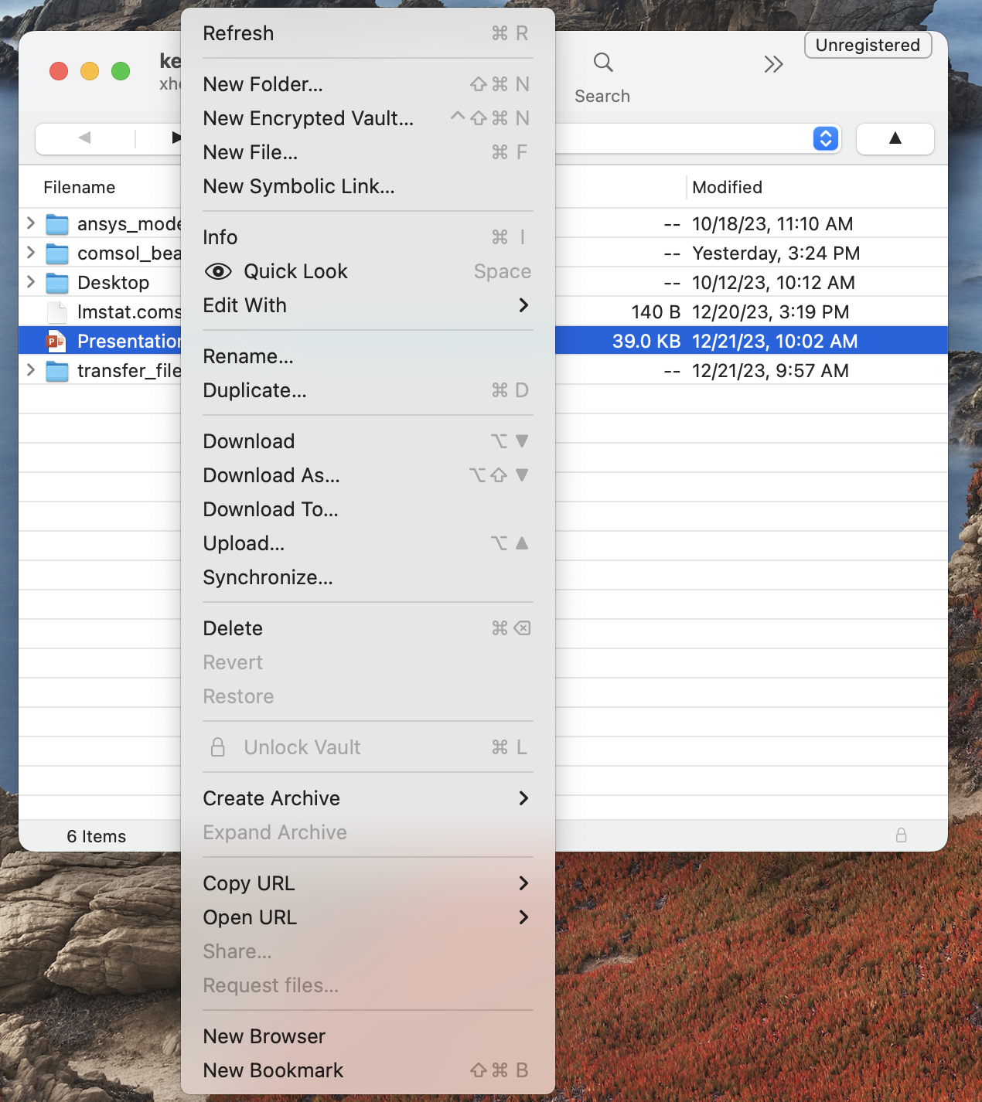
Running COMSOL In Batch Mode
File transfer
5. Drag files or folders to upload to or download from Kestrel and edit files as on laptop
4. Go to projects directory
Notes:
Next, let’s move forward to next topic about running comsol in batch mode. Once the model is built in GUI on either Kestrel or local workstation, copy and save the .mph to your home directory or project directory on kestrel. Then you need to write a sbatch script, by submitting the sbatch file from the directory where it is saved the comsol model will be calculated on a compute node.

Slide 23
Running COMSOL In Batch Mode
#!/bin/bash #SBATCH --job-name=comsol-batch-beam #SBATCH --time=00:20:00 #SBATCH --nodes=1 #SBATCH --account=<your-allocation-id>
#SBATCH –-partition=short #SBATCH --output=comsol-%j.out #SBATCH --error=comsol-%j.err # This helps ensure your job runs from the directory # from which you ran the sbatch command cd $SLURM_SUBMIT_DIR # Set up environment, and list to stdout for verification module purge module load comsol inputfile=$SLURM_SUBMIT_DIR/myinputfile.mph outputfile=$SLURM_SUBMIT_DIR/myoutputfilename # Run a COMSOL job with 104 threads. # -np = number of threads per rank comsol batch -np 104 -inputfile $inputfile -outputfile $outputfile
Run on single node with multiple cores.
Computing on GPU nodes is not currently supported by COMSOL!
Notes:
Here is a simple sbatch script sample used to run a comsol job on one node with multiple threads. in the first part you need to define the job name, time, number of nodes you are requiring, your project handle, types of nodes you are requiring. and the name of files to save output and error message. Then cd to the directory where this slurm file is saved. Load the comsol module, specify the name of input file which is your comsol .mph file, and the name of output file. Then the last line means we are using comsol module to calculate the input .mph model and save it to outputfile which is .mph file.
Note that, computing on GPU nodes is not currently supported by comsol, please remember to use cpu nodes.
Explain last line in detail. You can include more settings in this line.
Recommend to use half of cores.

Slide 24
Running COMSOL In Batch Mode
Create, save, and submit the sbatch file
Create and save the sbatch file:
cd ~ # get to home directory
mkdir comsol_beam # create a directory to save the sbatch file
cd ~/comsol_beam # get to the created directory
touch submit_comsol.slurm # create sbatch file
# copy the script in last slide to submit_comsol.slurm (vim)
cd to the directory where the sbatch file is located:
cd ~/comsol_beam
Submit the job:
sbatch submit_comsol.slurm
Notes:
This slides show how to create save and submit the sbatch file. Firstly, create an empty file, then copy the script in last slide to this empty file and save it. Then submit it by running the command sbatch.

Slide 25
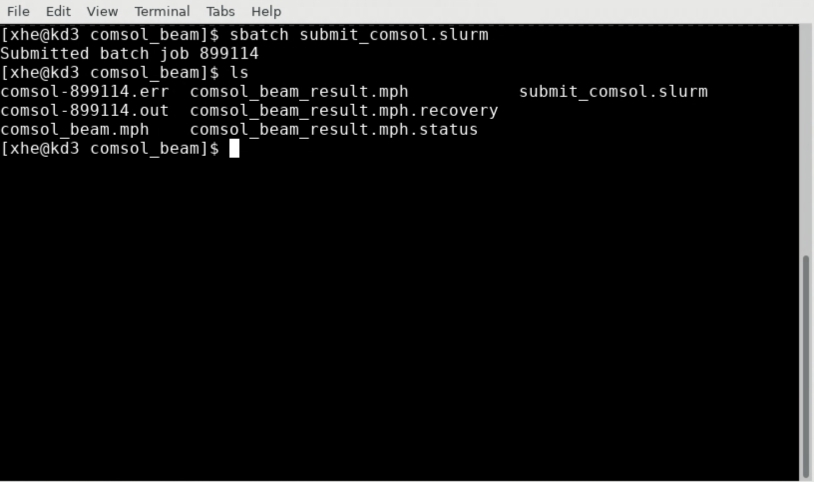
Running COMSOL In Batch Mode
comsol_beam.mph:
COMSOL model
Comsol_beam_result.mph:
calculated model with results
Notes:
After the job is finished, all file will generated in the specified directory. In this example, comsol_beam.mph is the model we are going to calculate and comsol_beam_result file is the calculated model with results.

Slide 26
Running COMSOL In Batch Mode
#!/bin/bash #SBATCH --job-name=comsol-batch-4proc #SBATCH --time=00:20:00 #SBATCH --nodes=2 #SBATCH --ntasks-per-node=2 #SBATCH --account=<your-allocation-id>
#SBATCH –partition=short #SBATCH --output=comsol-%j.out #SBATCH --error=comsol-%j.err # This helps ensure your job runs from the directory # from which you ran the sbatch command cd $SLURM_SUBMIT_DIR # Set up environment, and list to stdout for verification module purge module load comsol inputfile=$SLURM_SUBMIT_DIR/myinputfile.mph outputfile=$SLURM_SUBMIT_DIR/myoutputfilename # Run a 2-node, 4-rank parallel COMSOL job with threads for each rank. # -nn = total number of MPI ranks # -nnhost = number of MPI ranks per host # -np = number of threads per rank comsol –nn 4 -nnhost 2 batch -np 52 -inputfile $inputfile -outputfile $outputfile
Run on multiple nodes
Notes:
Calculate comsol model on multiple nodes is straight forward. This slide show a example script to compute comsol model using 2 nodes, 4 ranks, and 52 threads per rank.

Slide 27
Running COMSOL In Batch Mode
#!/bin/bash #SBATCH --job-name=comsol-batch-beam #SBATCH --time=00:20:00 #SBATCH --nodes=1 #SBATCH --account=<your-allocation-id>
#SBATCH –-partition=shared #SBATCH --output=comsol-%j.out #SBATCH --error=comsol-%j.err # This helps ensure your job runs from the directory # from which you ran the sbatch command cd $SLURM_SUBMIT_DIR # Set up environment, and list to stdout for verification module purge module load comsol inputfile=$SLURM_SUBMIT_DIR/myinputfile.mph outputfile=$SLURM_SUBMIT_DIR/myoutputfilename # Run a COMSOL job with 104 threads. # -np = number of threads per rank comsol batch -np 13 -inputfile $inputfile -outputfile $outputfile
Run on shared node with 13 cores.
Notes:
Which type of nodes can enable the submitted job start immediately?
Run on a shared node with 13 cores.

Slide 28
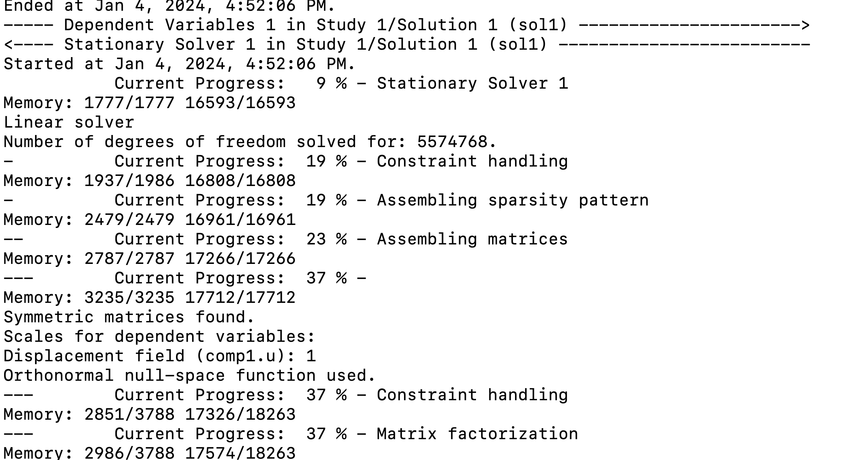
Running COMSOL In Batch Mode
Check progress
Show real time progress:
tail –f comsol-jobID.out
Exit tail: control+c
Notes:
Which type of nodes can enable the submitted job start immediately?
Run on a shared node with 13 cores.

Slide 29
Demo
lmstat.comsol command.
Connect to DAV node using FastX.
Run COMSOL GUI.
Run COMSOL in sbatch mode.
Notes:
At the end, I would like to give you a demo which covers most stuff in previous slides using a simple cantilever beam model.

Slide 30
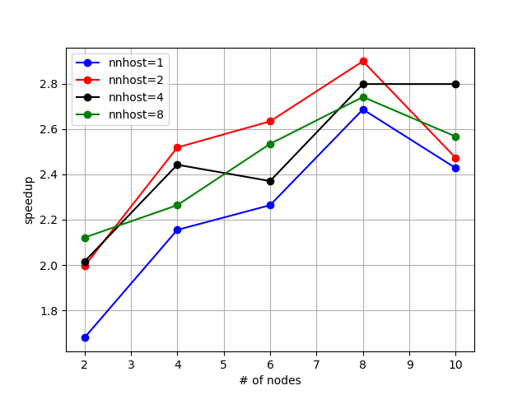
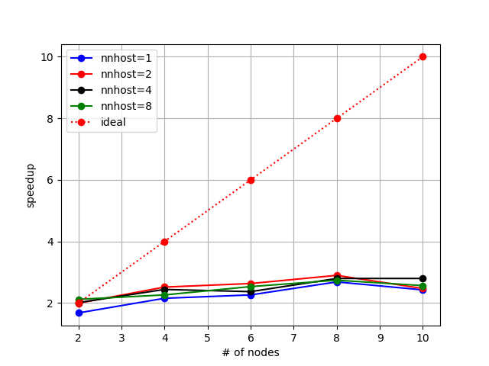
Scaling Performance
What is scaling performance?
How the solution time varies with the number of processors for a fixed total problem size.
How to test the scaling performance of COMSOL?
Run the model with different number of cores and plot running time/speed up vs number of cores
Run on short nodes;
DOFs: ~5M
Scaling performance depends on:
- size of the model
- element type
- solver
…
Notes:
At the end, I would like to give you a demo which covers most stuff in previous slides using a simple cantilever beam model.

Slide 31
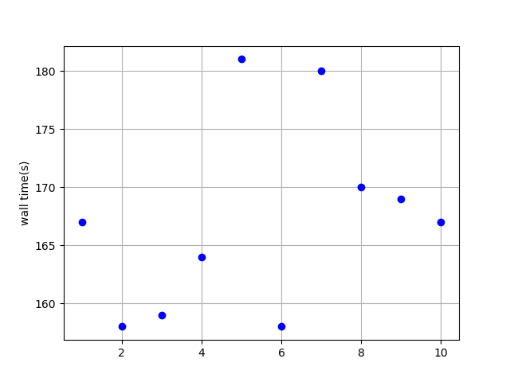
Scaling Performance
6 nodes;
nn=12;
nnhost=2;
Np=52;
Notes:
At the end, I would like to give you a demo which covers most stuff in previous slides using a simple cantilever beam model.

Slide 32
Resources
Creating an HPC account
https://www.nrel.gov/hpc/user-accounts.html
Getting a pilot allocation: (necessary to use Kestrel)
Instructions: https://www.nrel.gov/hpc/resource-allocation-requests.html
Request link: https://hpcprojects.nrel.gov/
Additional information about allocation units: https://www.nrel.gov/hpc/system-resource-allocation-unit.html
Getting started on Kestrel
HPC FAQ: https://nrel.github.io/HPC/Documentation/getting_started/
Running a job: https://nrel.github.io/HPC/Documentation/Slurm/batch_jobs/
Running an interactive job: https://nrel.github.io/HPC/Documentation/Slurm/interactive_jobs/
Moving data between your laptop and Kestrel: https://nrel.github.io/HPC/Documentation/Managing_Data/Transferring_Files/
Other computing questions/inquiries, email:
hpc-help@nrel.gov
Notes:
The content in previous slides should be enough to get you started with comsol on Kestrel, however, if you want to learn more about kestrel, you can refer to the resources listed here.

Slide 33
Thank you, questions?
Notes:
That’s pretty much of my talk Thank you for your attention. I am open to answer any questions you may have.

